Slide 1
CSM Celebrates!
College of the Sciences and Mathematics
2022 Student Recognition
& Awards Ceremony

Slide 2
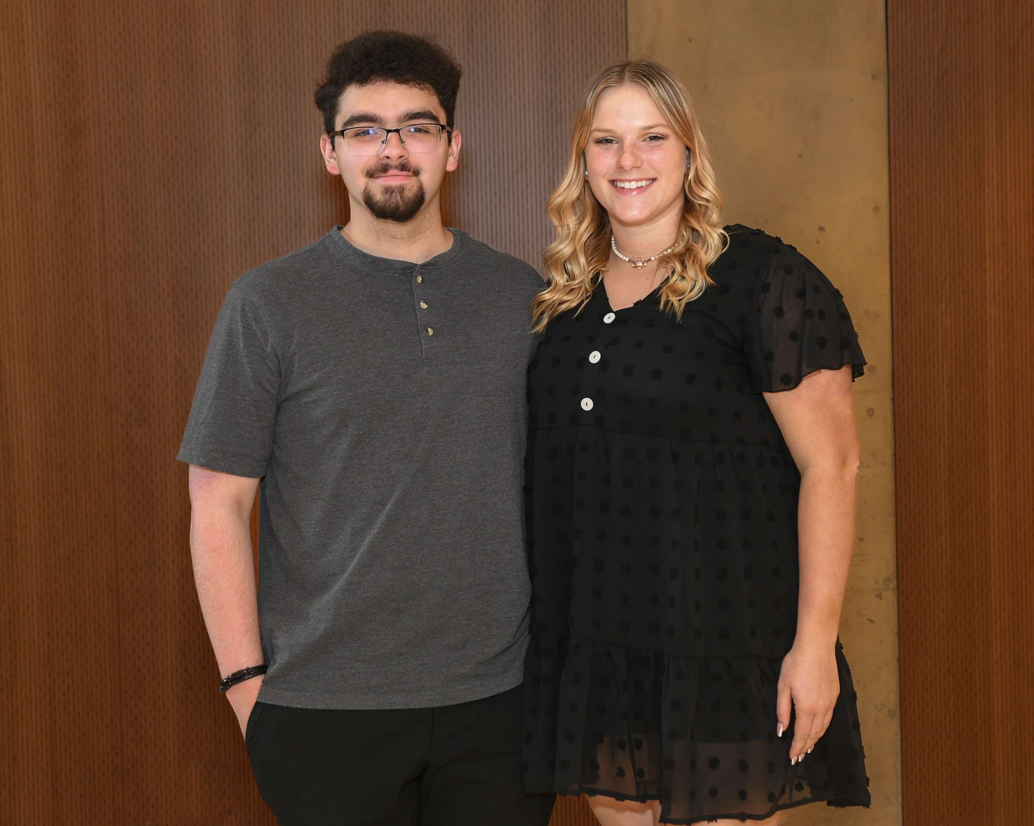
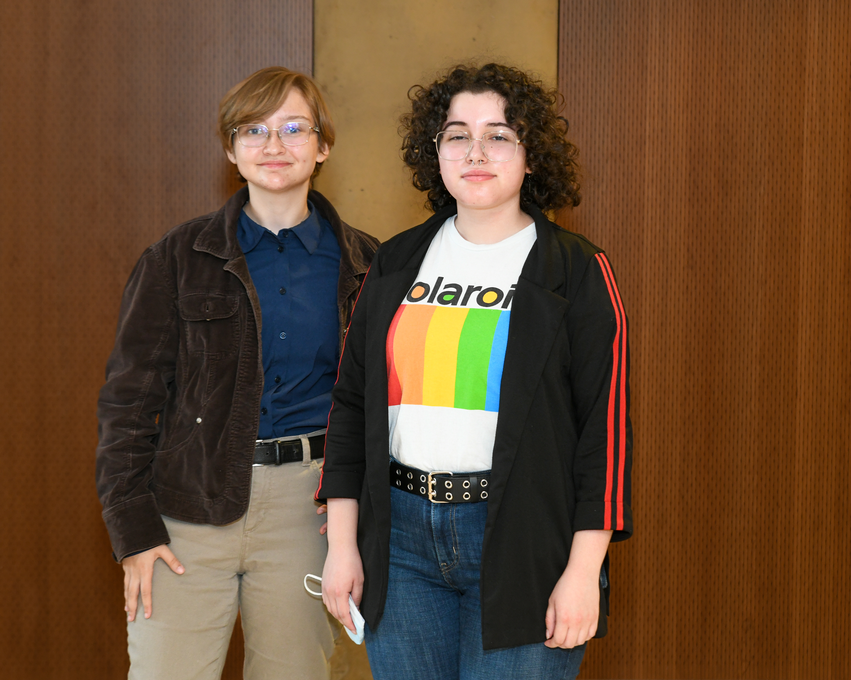
CSM 2022 Award Winners
Pictured: Alex Orr, Sarah Hogan, Emily Nicole Miller, and Leslie Sintes
Notes:
Vernon intro slides (2mins)

Slide 3
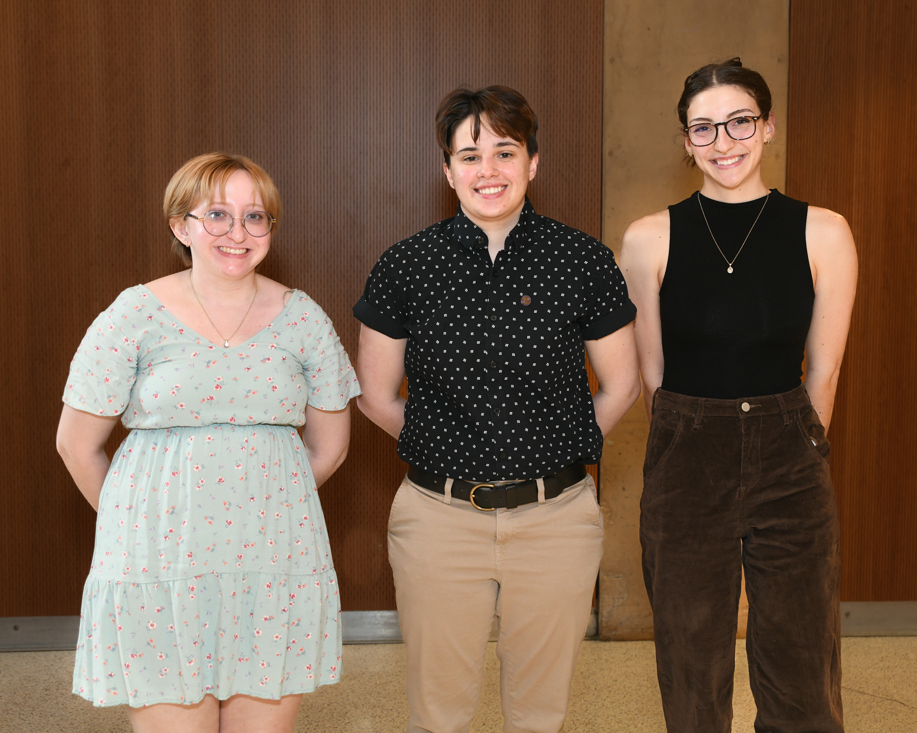
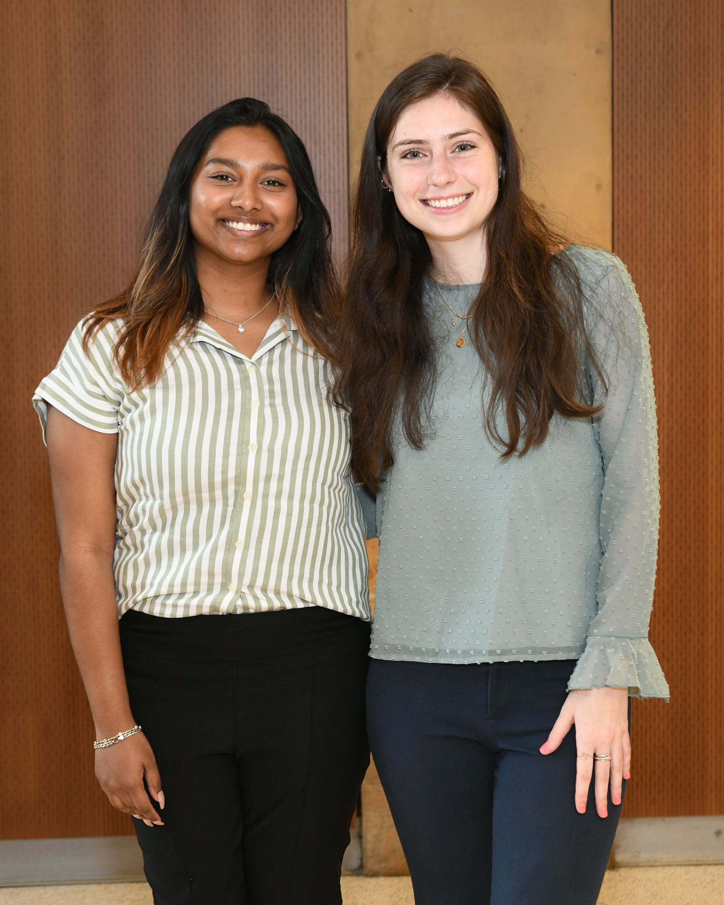
CSM 2022 Award Winners
Pictured: Jocelyn Brown, Jackie DiPietro, Lauren Torres, Sristi Fazal and Shawn Menden
Notes:
Vernon intro slides (2mins)

Slide 4
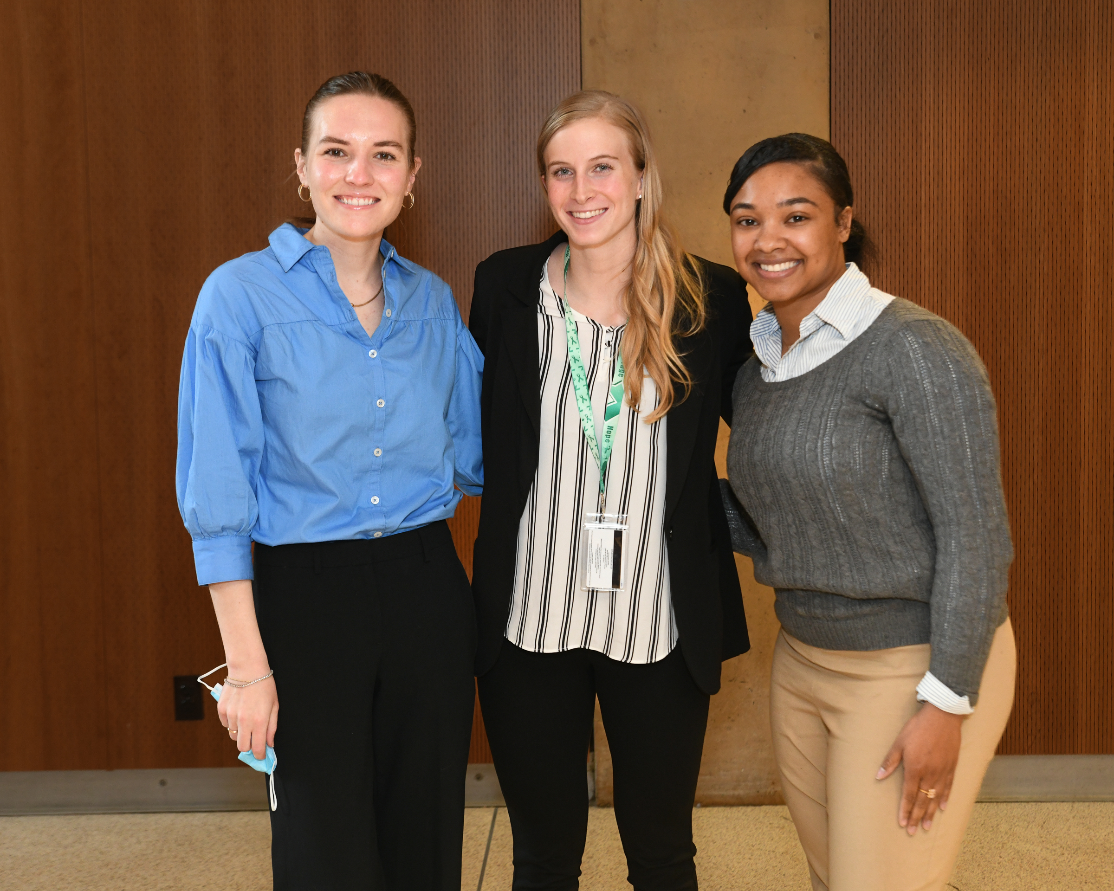
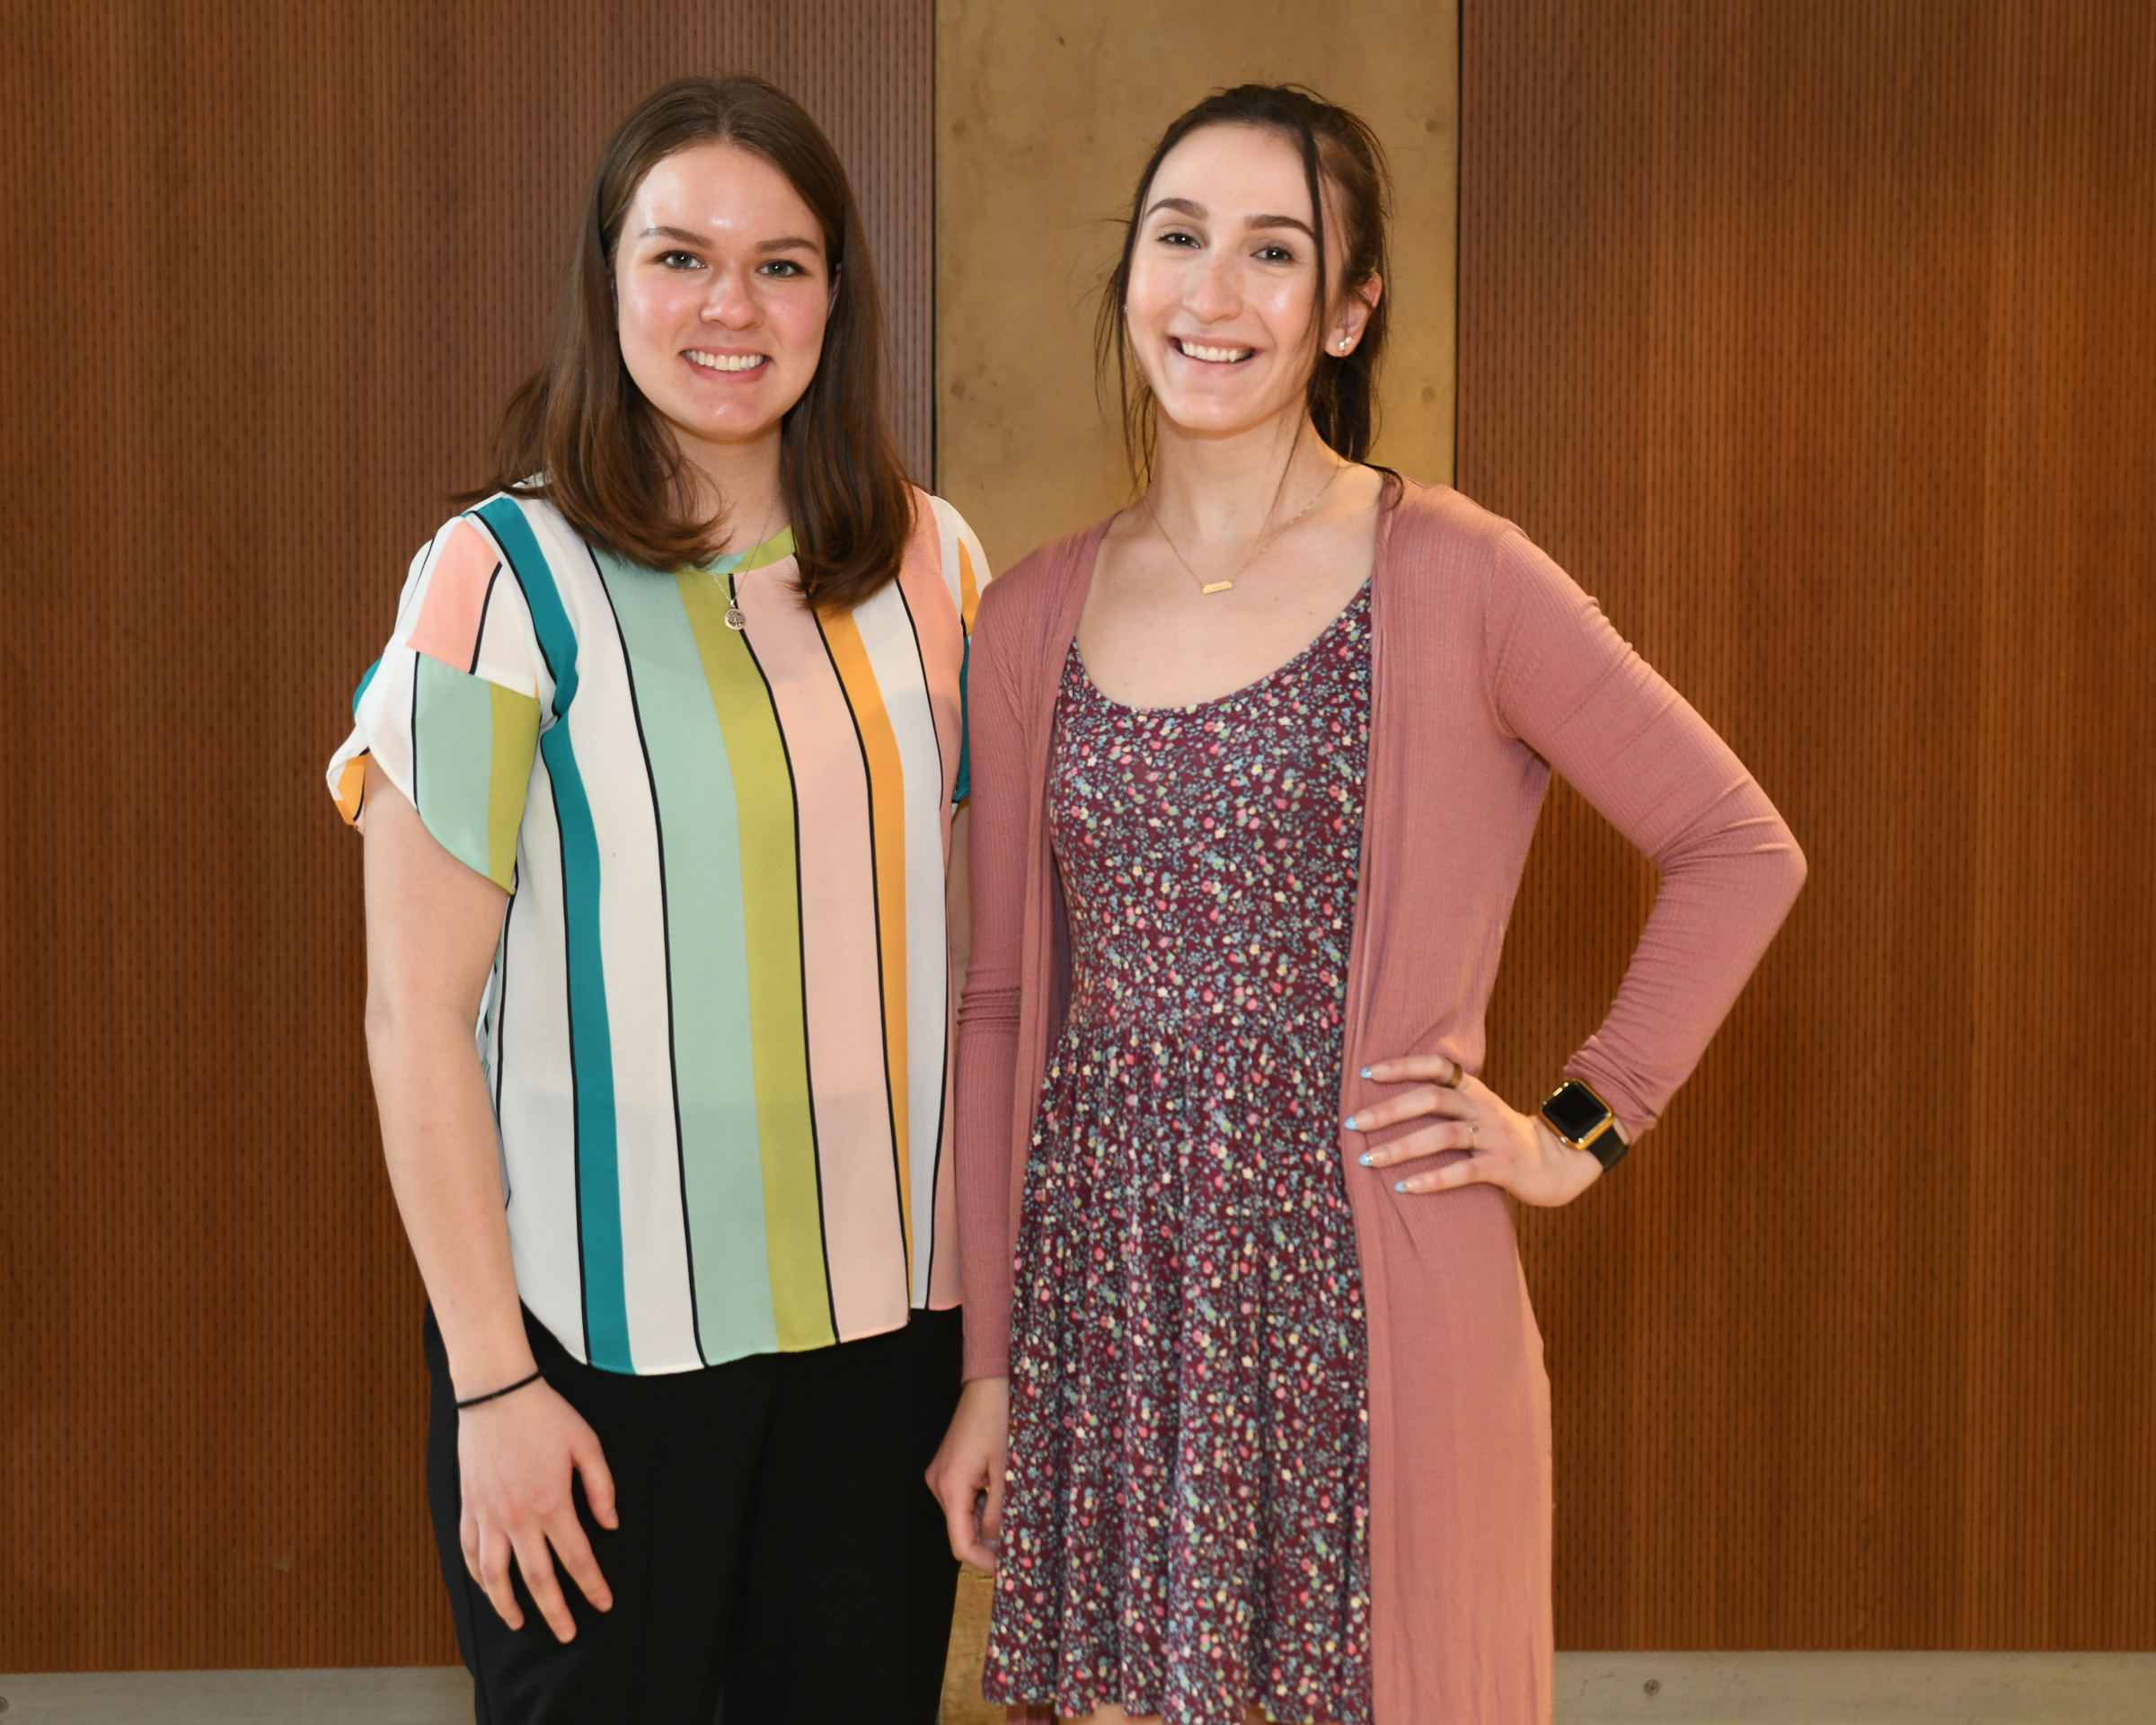
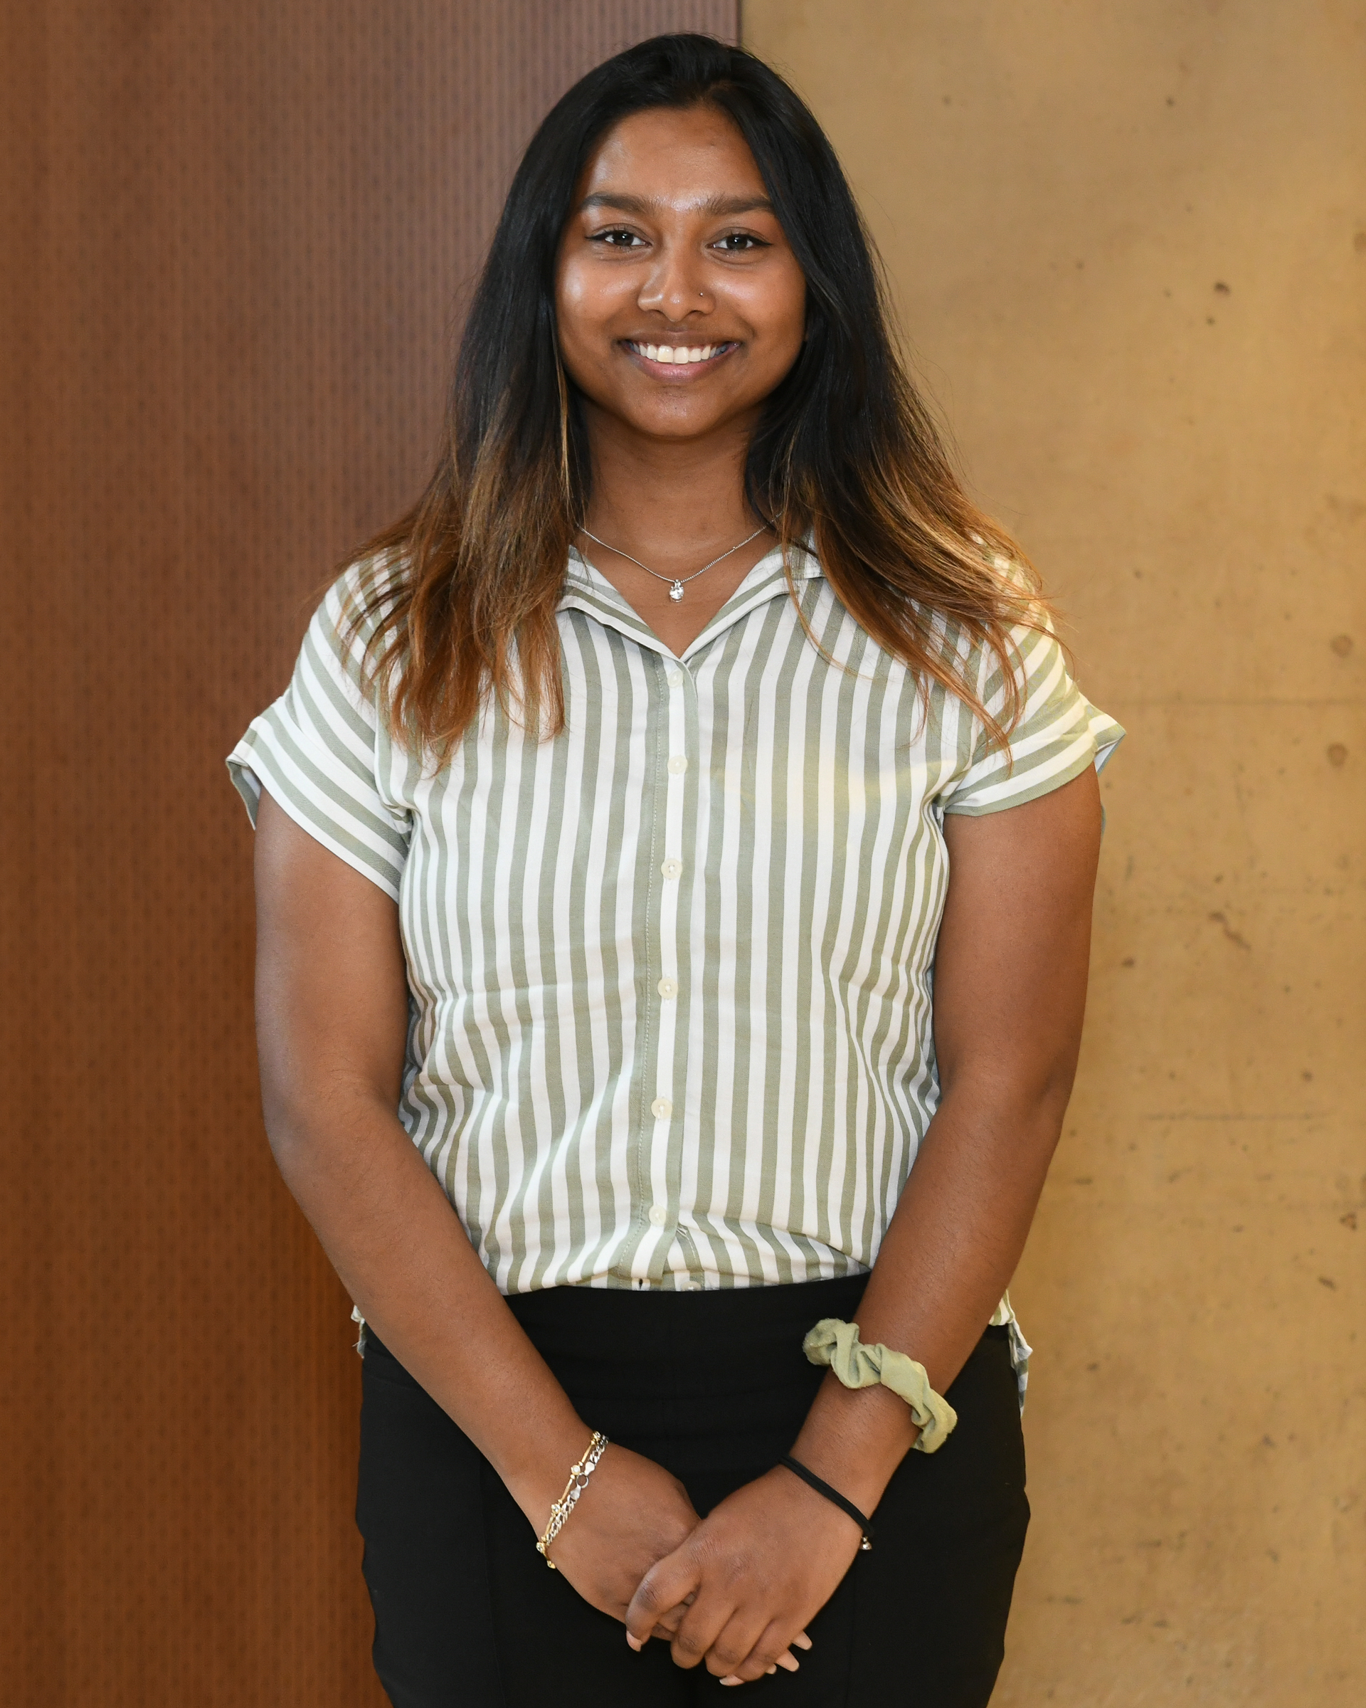
CSM 2022 Poster Session Award Winners
Pictured: Kayla Butts, Natalie Kline, Sarah Polohovich, Sristi Fazal, Katherine Kerr and Sabrina Avanzato
Notes:
Vernon intro slides (2mins)

Slide 5
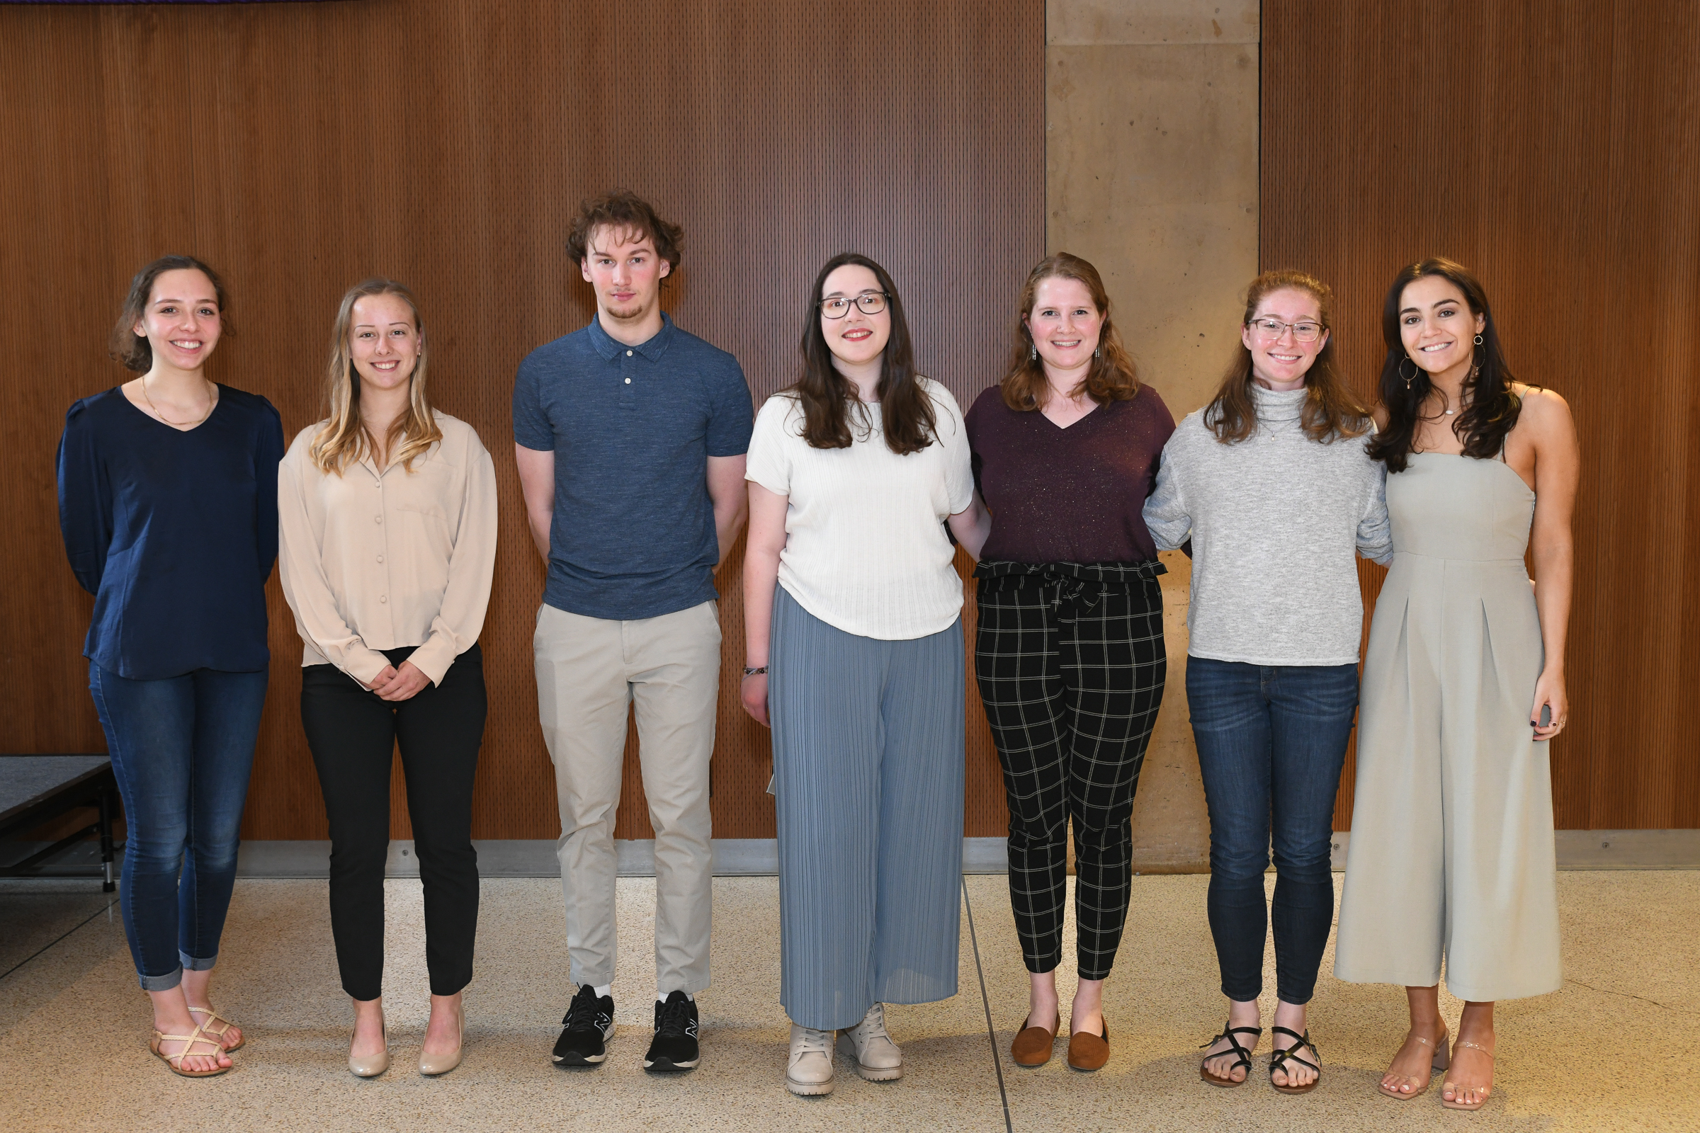
CSM 2022 Undergraduate Student Research Award Winners
Pictured: Brittany Hanson, Emma Harris, Jessica Ann Miller, Margaret Prezuhy. Sarah Smith, Sara Stavely and Daniel Wagner
Notes:
Vernon intro slides (2mins)

Slide 6
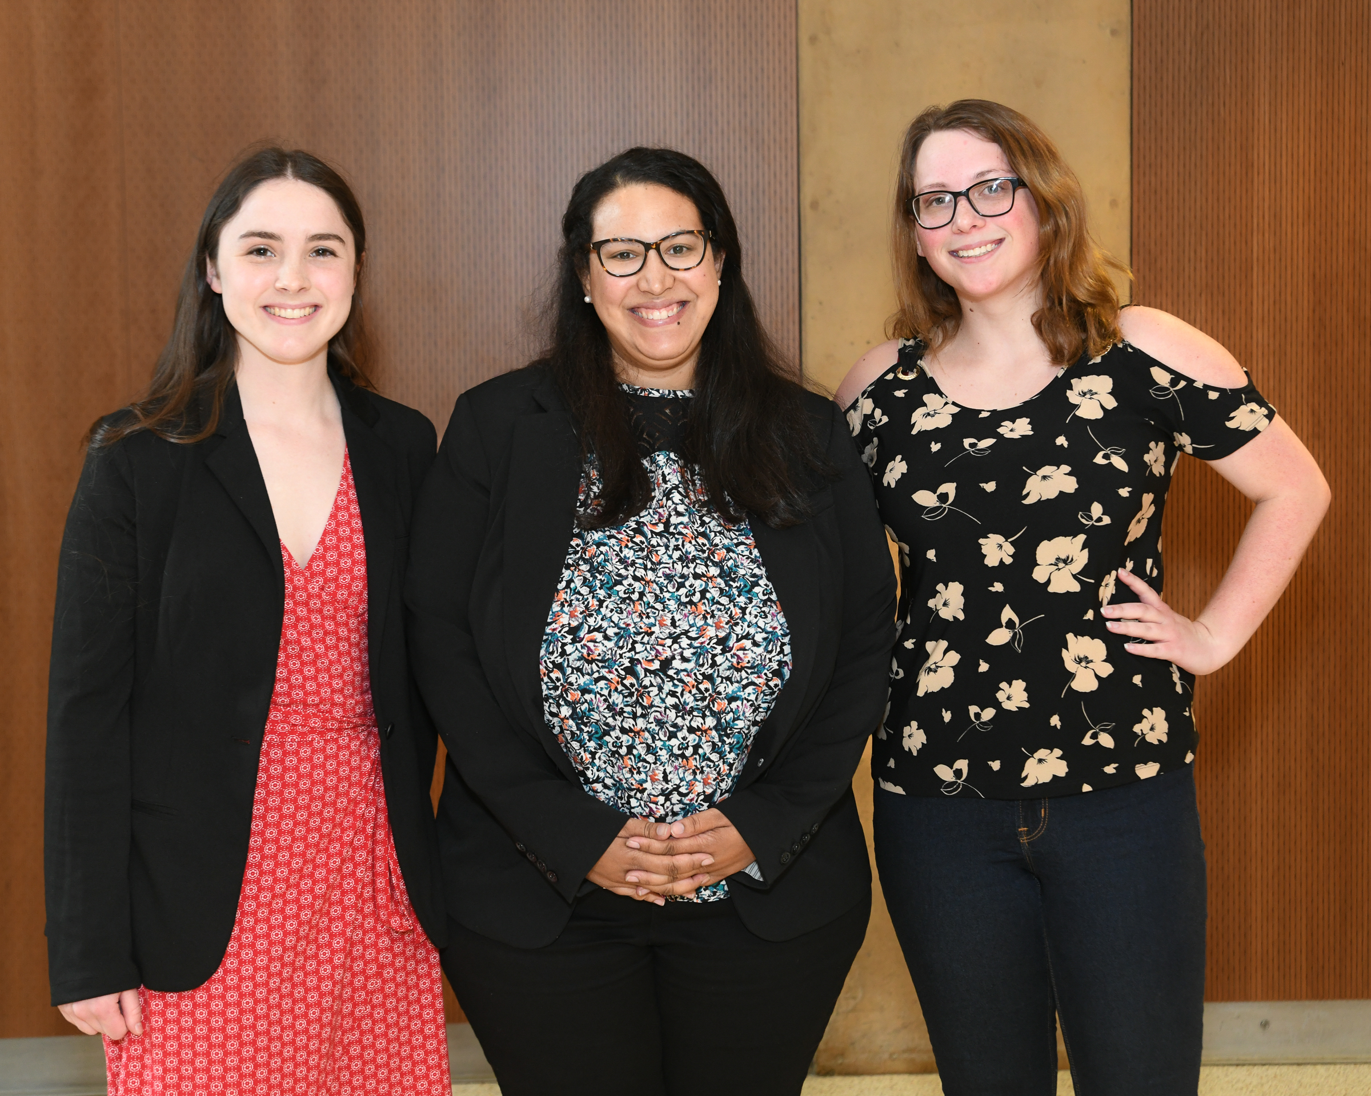
CSM 2022 Graduate Student Research Award Winners
Pictured: Rosa Boniface, Katherine Dowling and Lydia Stone
Notes:
Vernon intro slides (2mins)

Slide 7
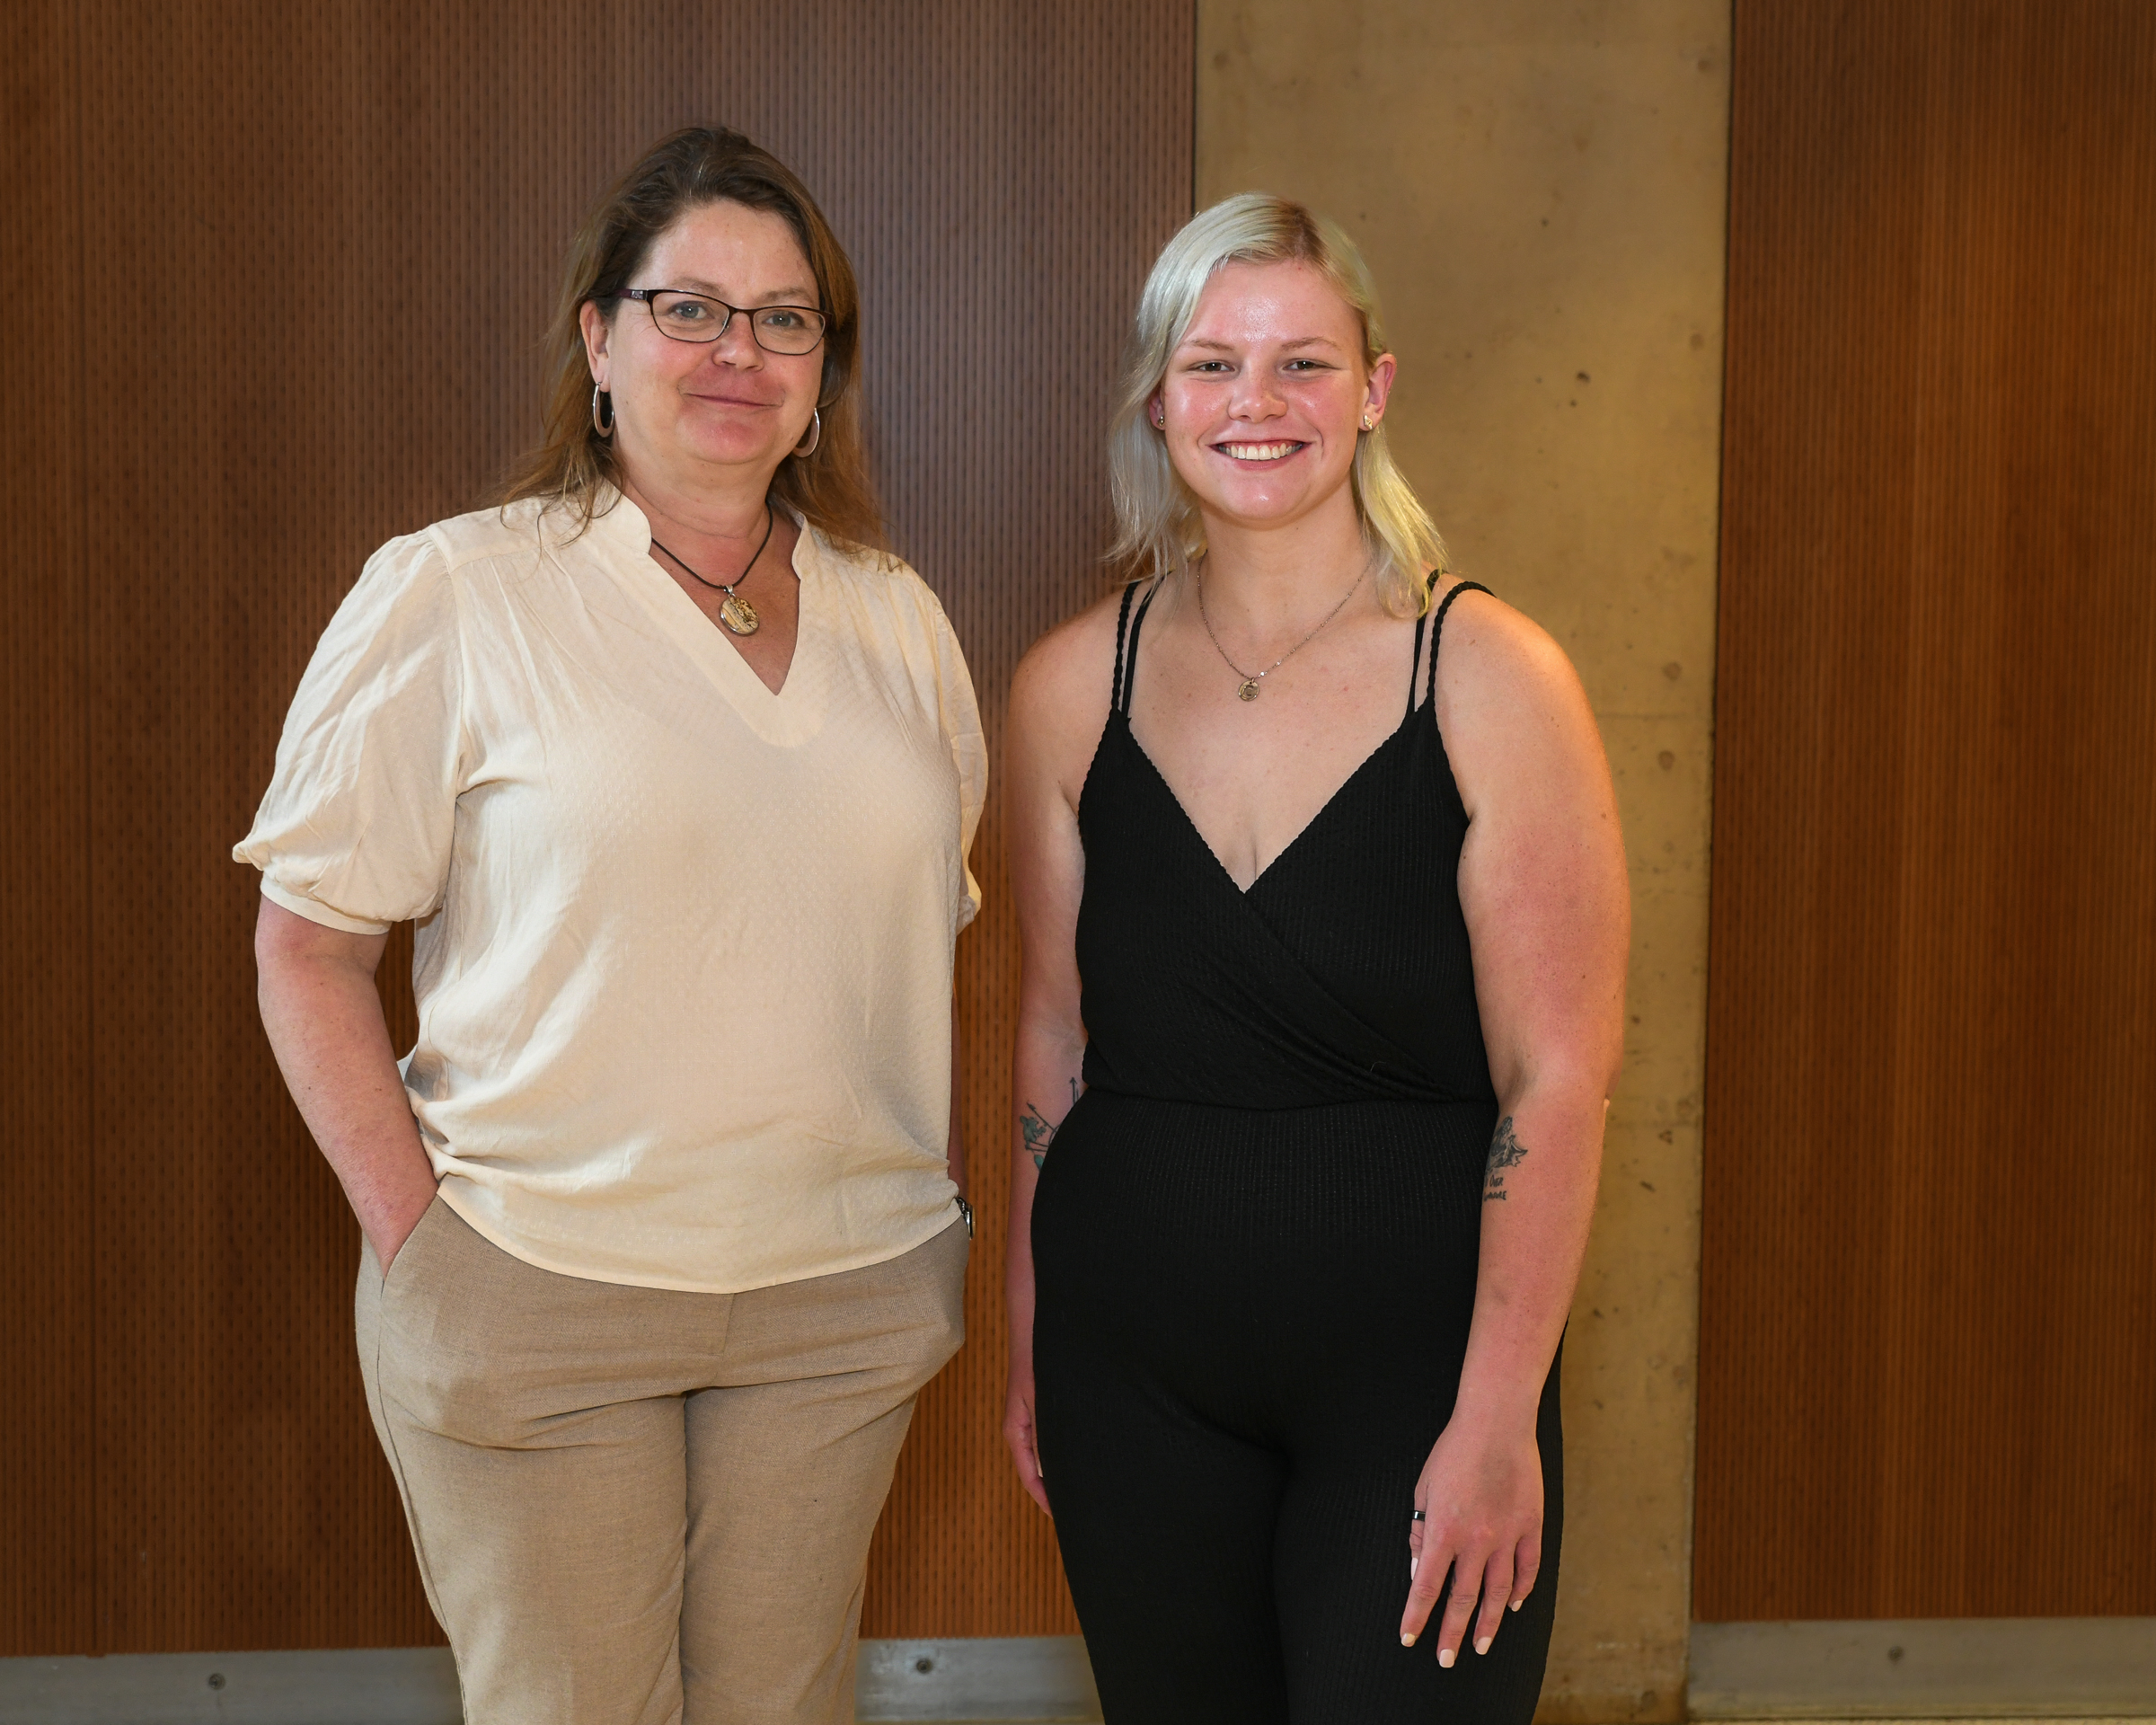
Anthropology 2022 Award Winner
Pictured: Dr. Heather Wholey & Joanna Maurer
Notes:
Vernon intro slides (2mins)

Slide 8
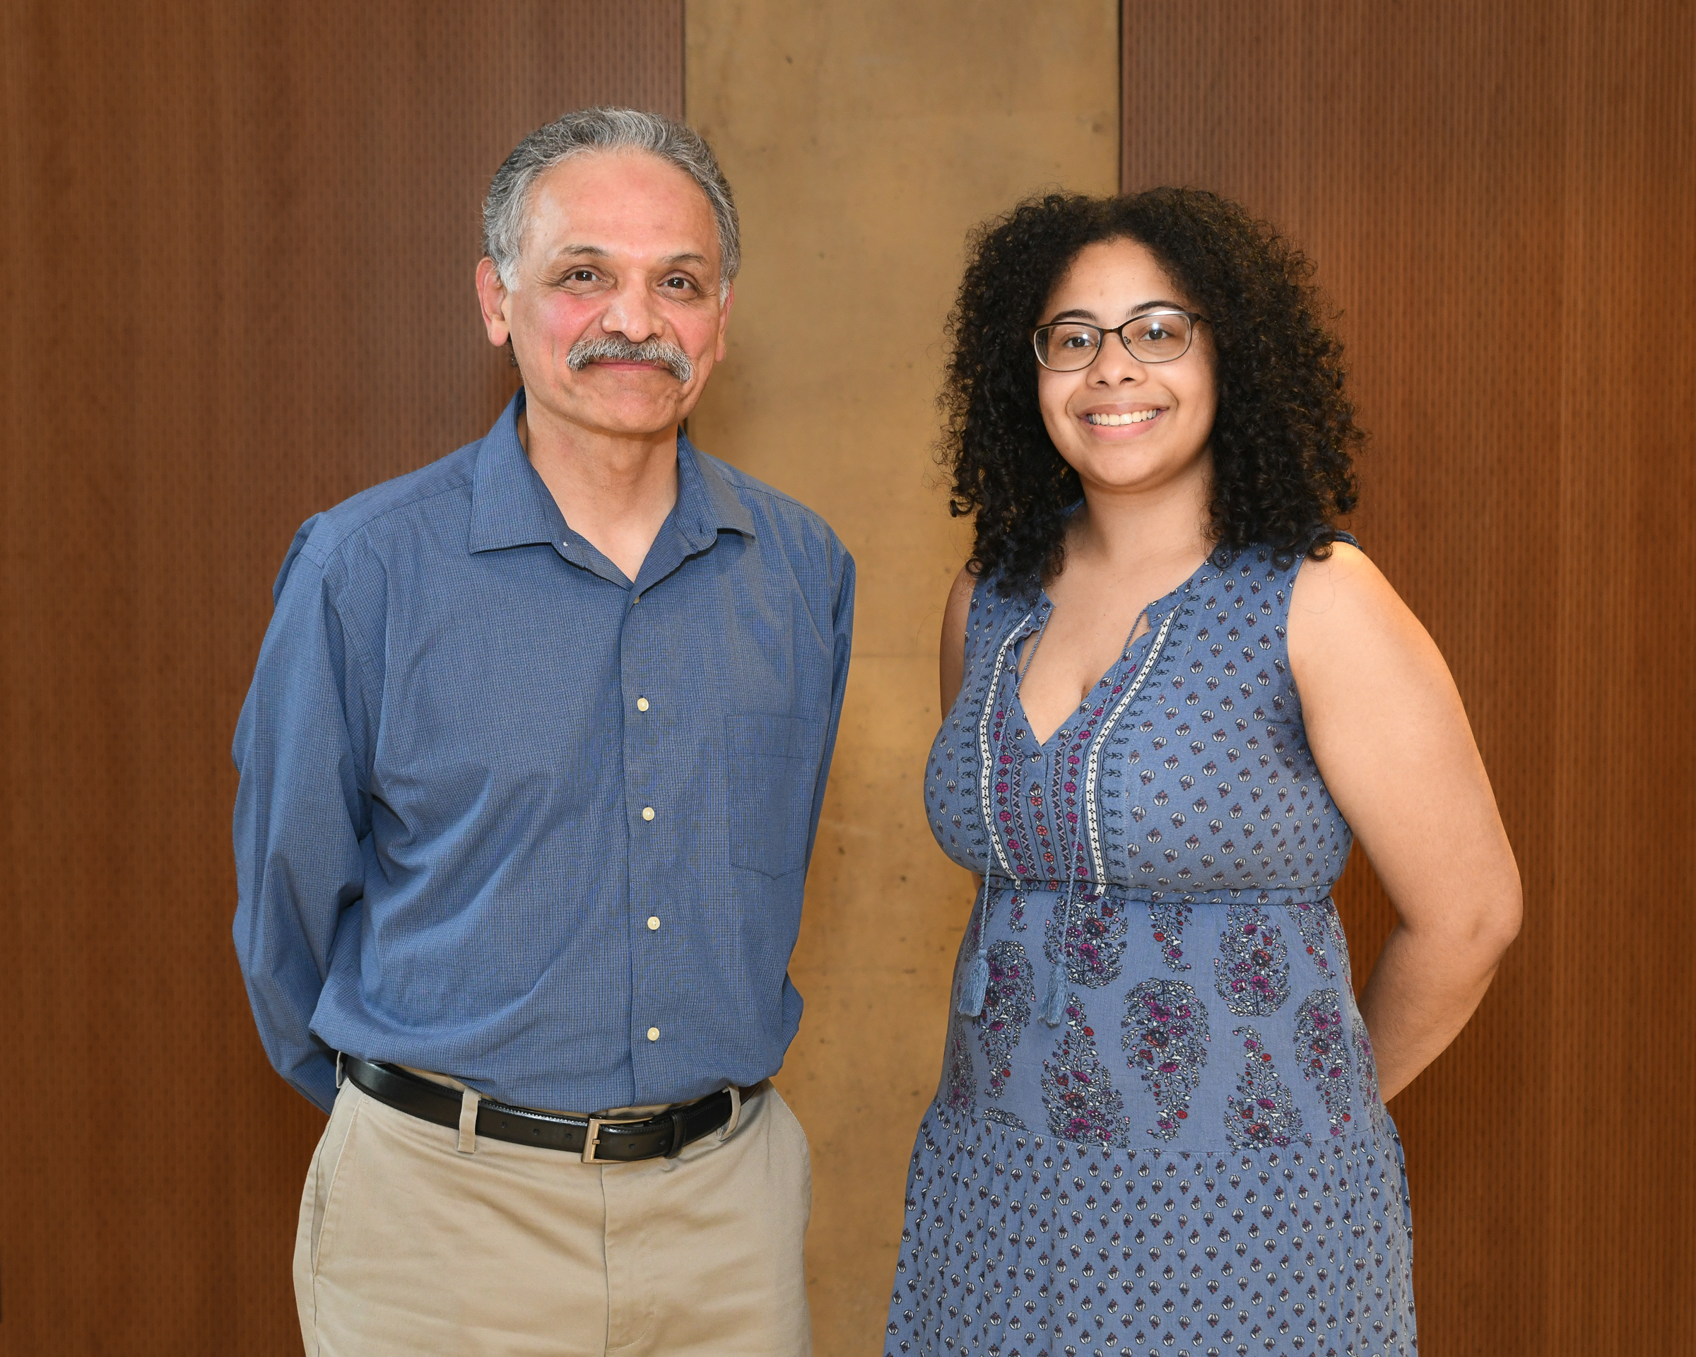
Sociology 2022 Award Winner
Pictured: Dr. Miguel Ceballos & Deannaliz Batista
Notes:
Vernon intro slides (2mins)

Slide 9
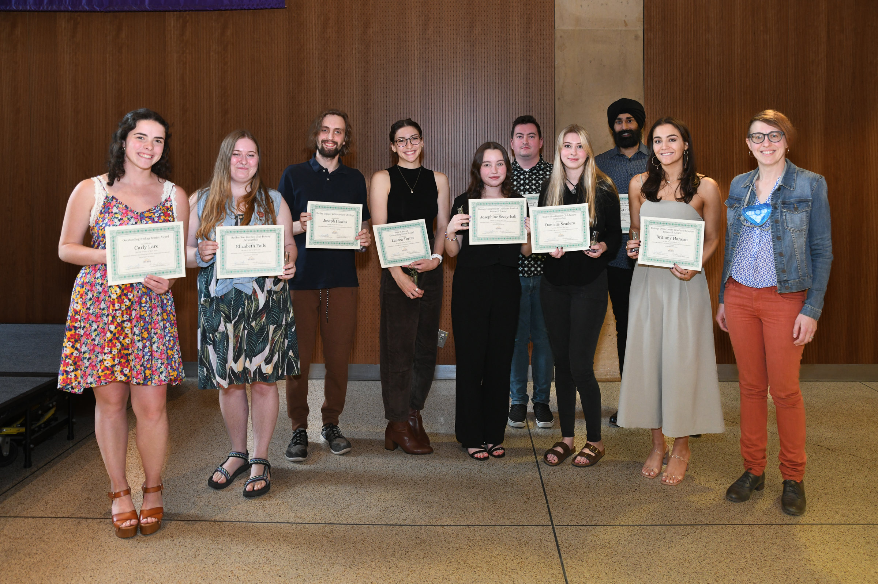
Biology 2022 Award Winners
Pictured: Lauren Torres, Danielle Scudero, Elizabeth Eads, Matt Fuchs, Josephine Szczyrback, Brittany Hanson, Gurpreet Bhasin, Carly Lare, Joe Hawks and Dr. Megan Fork
Notes:
Vernon intro slides (2mins)

Slide 10
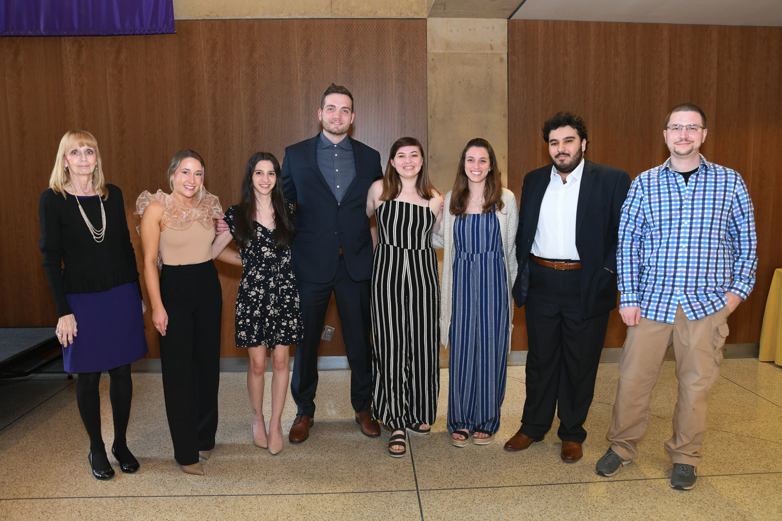
Chemistry 2022 Award Winners
Pictured: Dr. Melissa Cichowicz, Conner Balickie, Armin Mahdavi, Ashley Loignon, Carley Cirafesi, Kai Goldenstein Vonkiel, Juliana Hetzel and Hunter Paige Trzeciak
Notes:
Vernon intro slides (2mins)

Slide 11
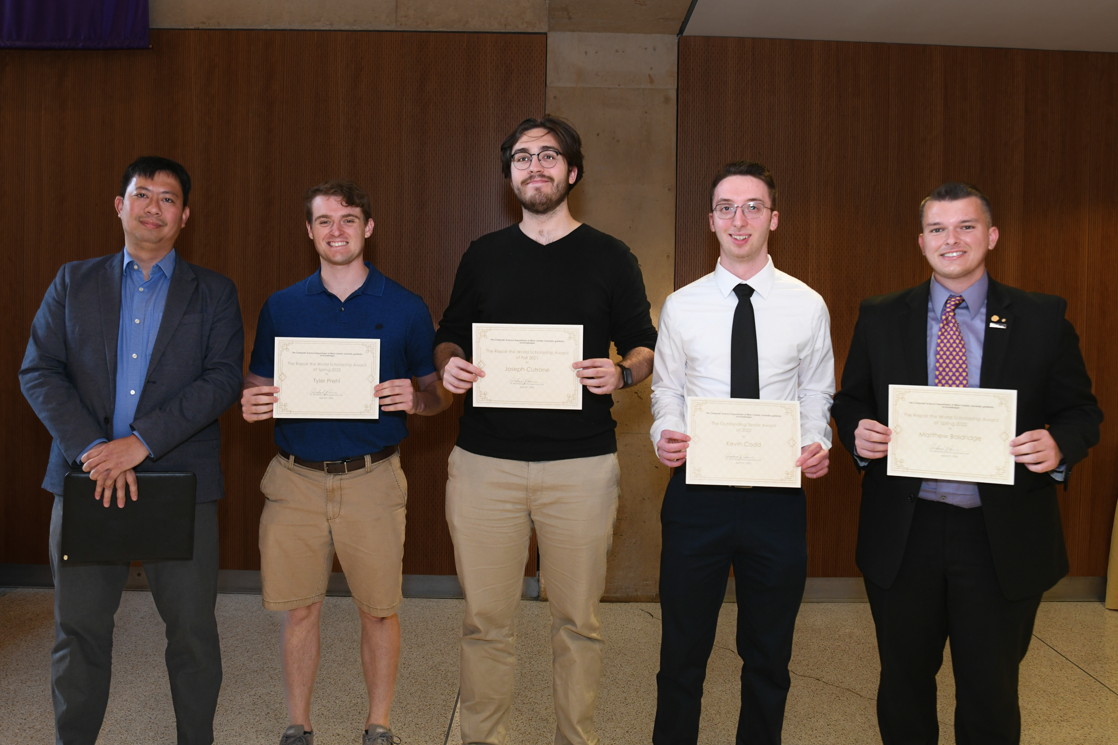
Computer Science 2022 Award Winners
Pictured: Dr. Linh Ngo, Kevin Codd, Matthew Baldridge, Tyler Prehl and Joseph Cutrone
Notes:
Vernon intro slides (2mins)

Slide 12
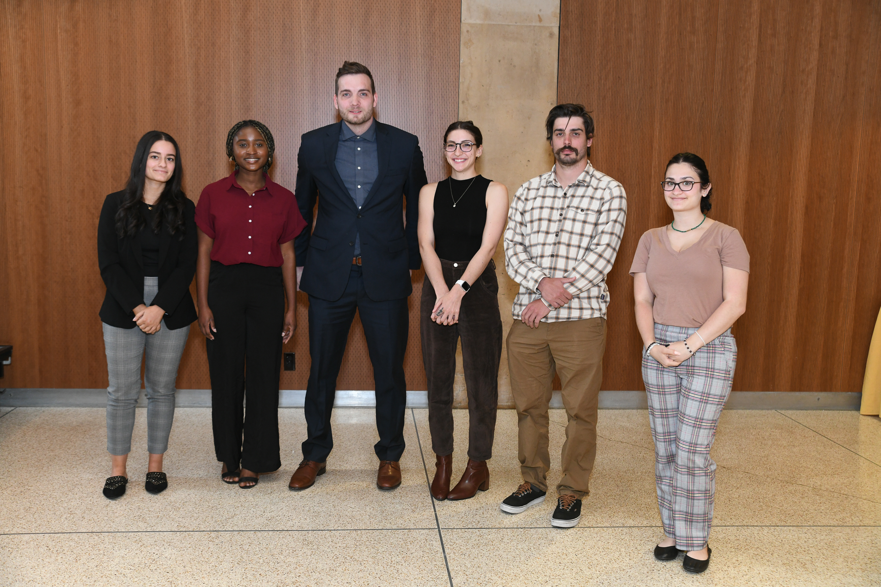
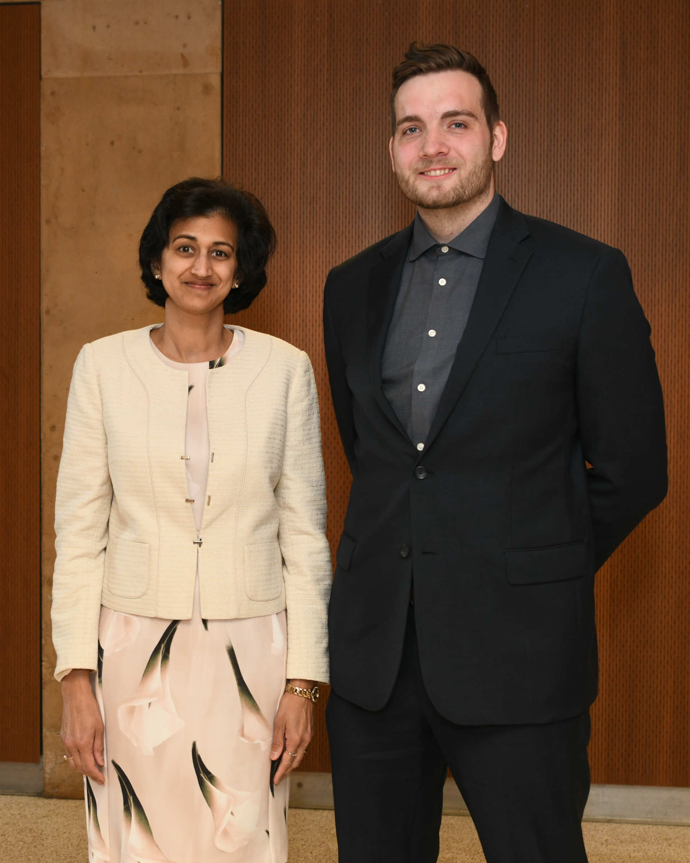
CSM 2022 Outstanding Student Award Nominees & Winner
Pictured: Wura Adeshina, Lauren Torres, Ian Romig, Helen Madanat, Hannah Crespy and Kai Vonkiel
Outstanding Student Award Winner: Kai Vonkiel, pictured with Dean Radha Pyati
Notes:
Vernon intro slides (2mins)

Slide 13
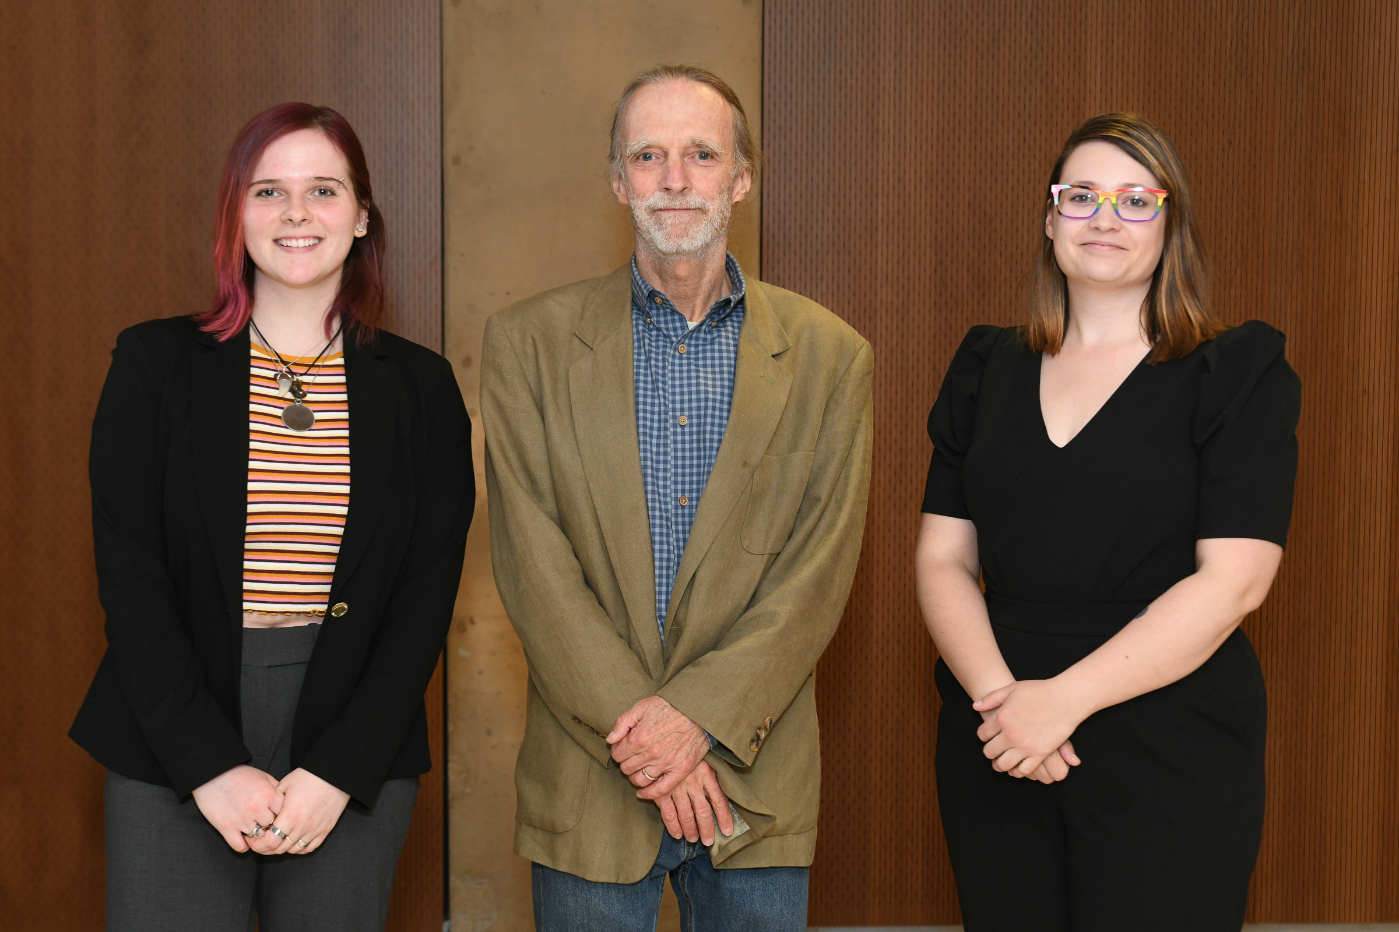
Earth & Space Sciences 2022 Award Winners
Pictured: Cora Delores, Dr. Howell Bosbyshell and Danielle Scott
Notes:
Vernon intro slides (2mins)

Slide 14
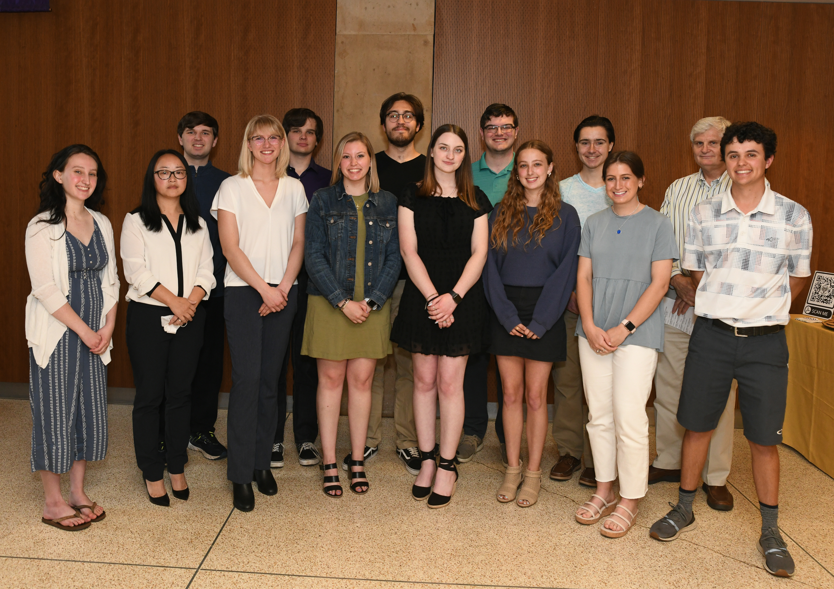
Mathematics 2022 Award Winners
Pictured: Dr. Peter Glidden, Meghan Thomas, Hannah McGovern, Julia Zelinsky, Joseph Cutrone, Bill Timmann, Gwenyth Meder, Catherine He Wang, Jennifer Katherine Byrne, Tyler Sarge, Ethan Whitney, Austin Schreffler, Andrew Heneghan, Gabriella Schatz
Notes:
Vernon intro slides (2mins)

Slide 15
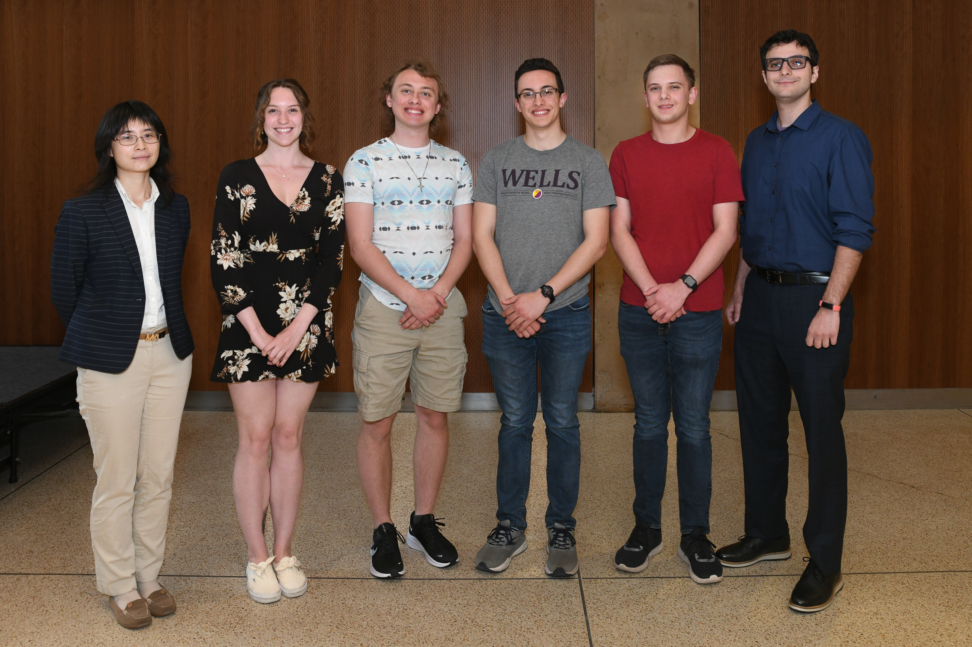
Physics 2022 Award Winners
Pictured: Dr. Tianran Chen, Jaleel Laraki, Matthew Braun, Nicholas Gray, Logan Suchanec and Kylie Hershey
Notes:
Vernon intro slides (2mins)

Slide 16
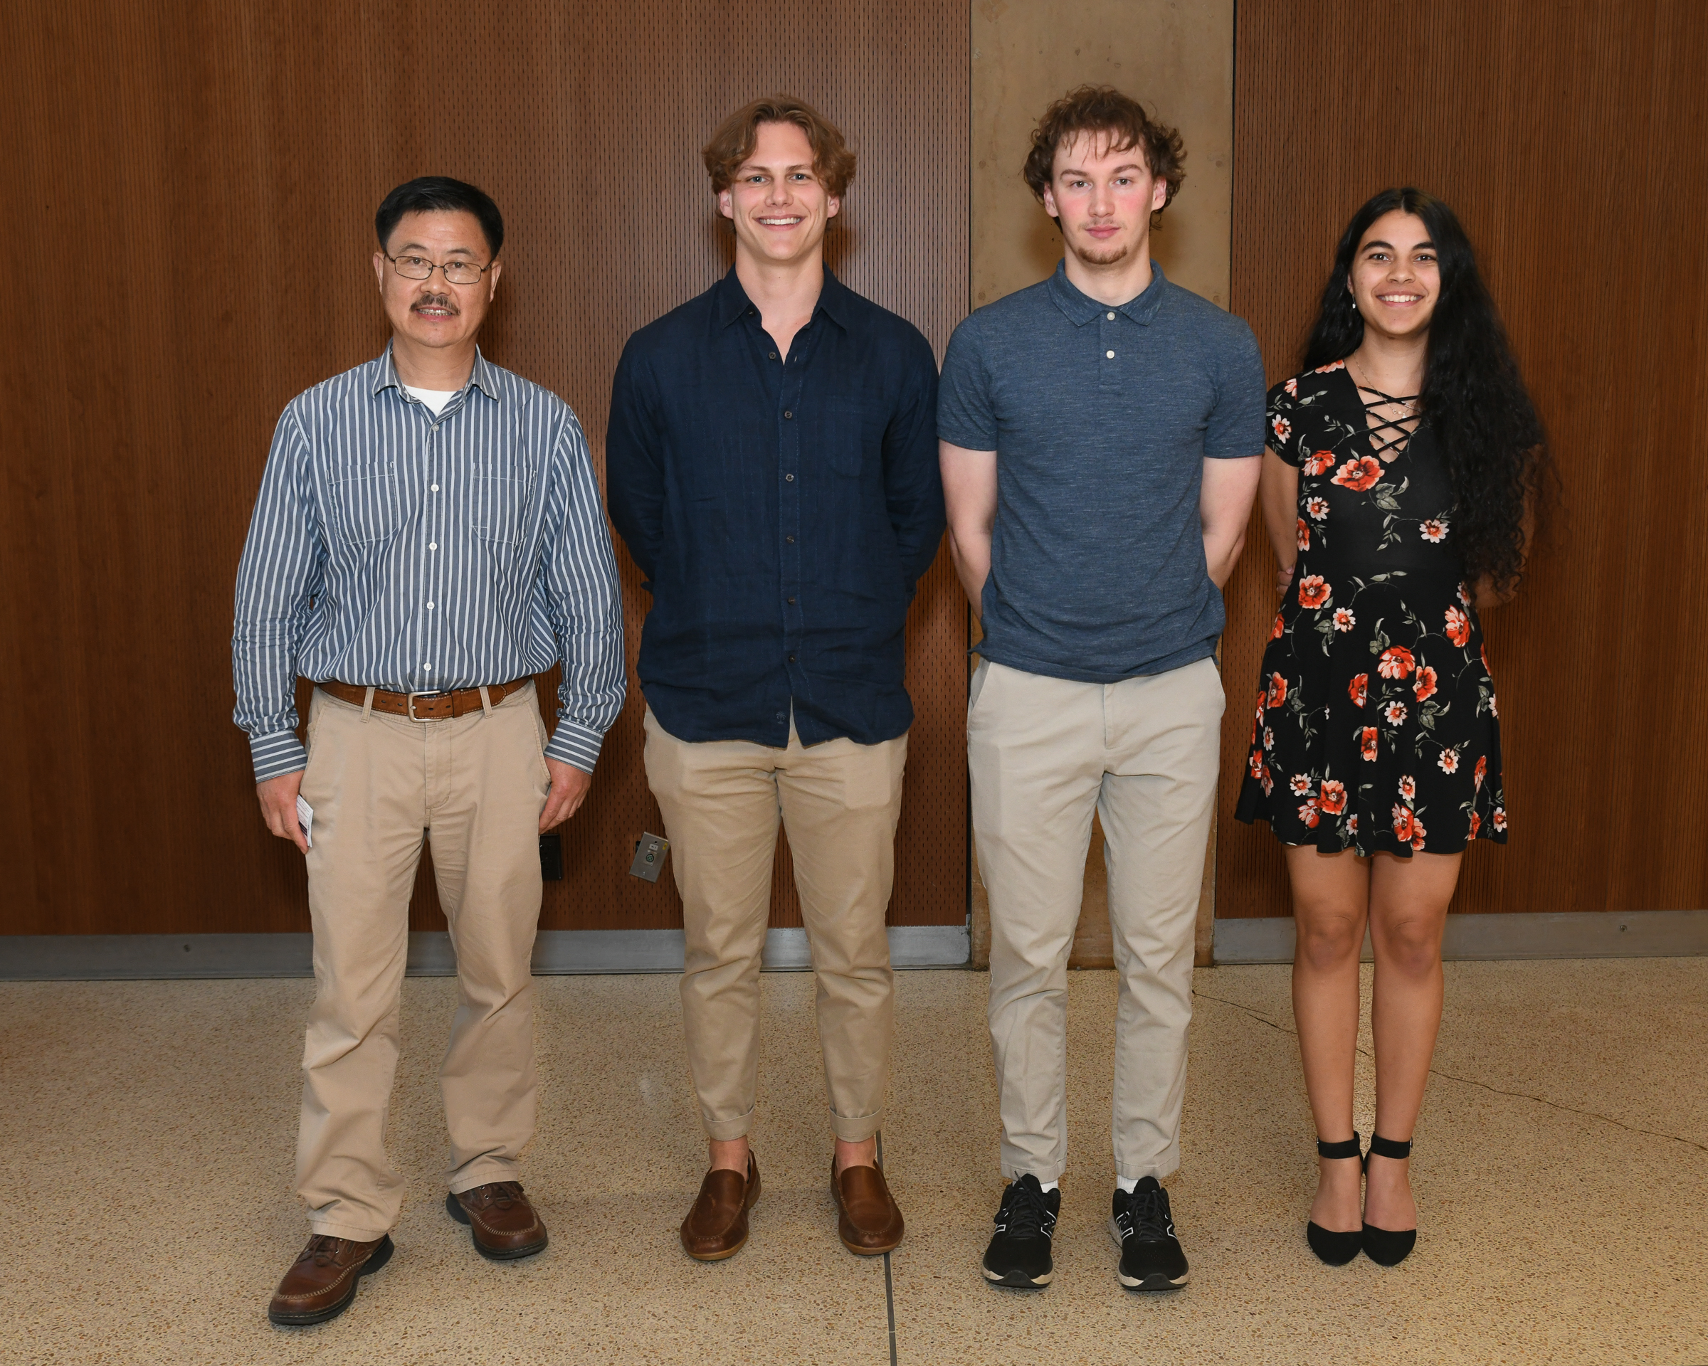
Biomedical Engineering 2022 Award Winners
Pictured: Dr. Zhongping Huang, Matthew Morris, Daniel Wagner and Diana Palade
Notes:
Vernon intro slides (2mins)

Slide 17
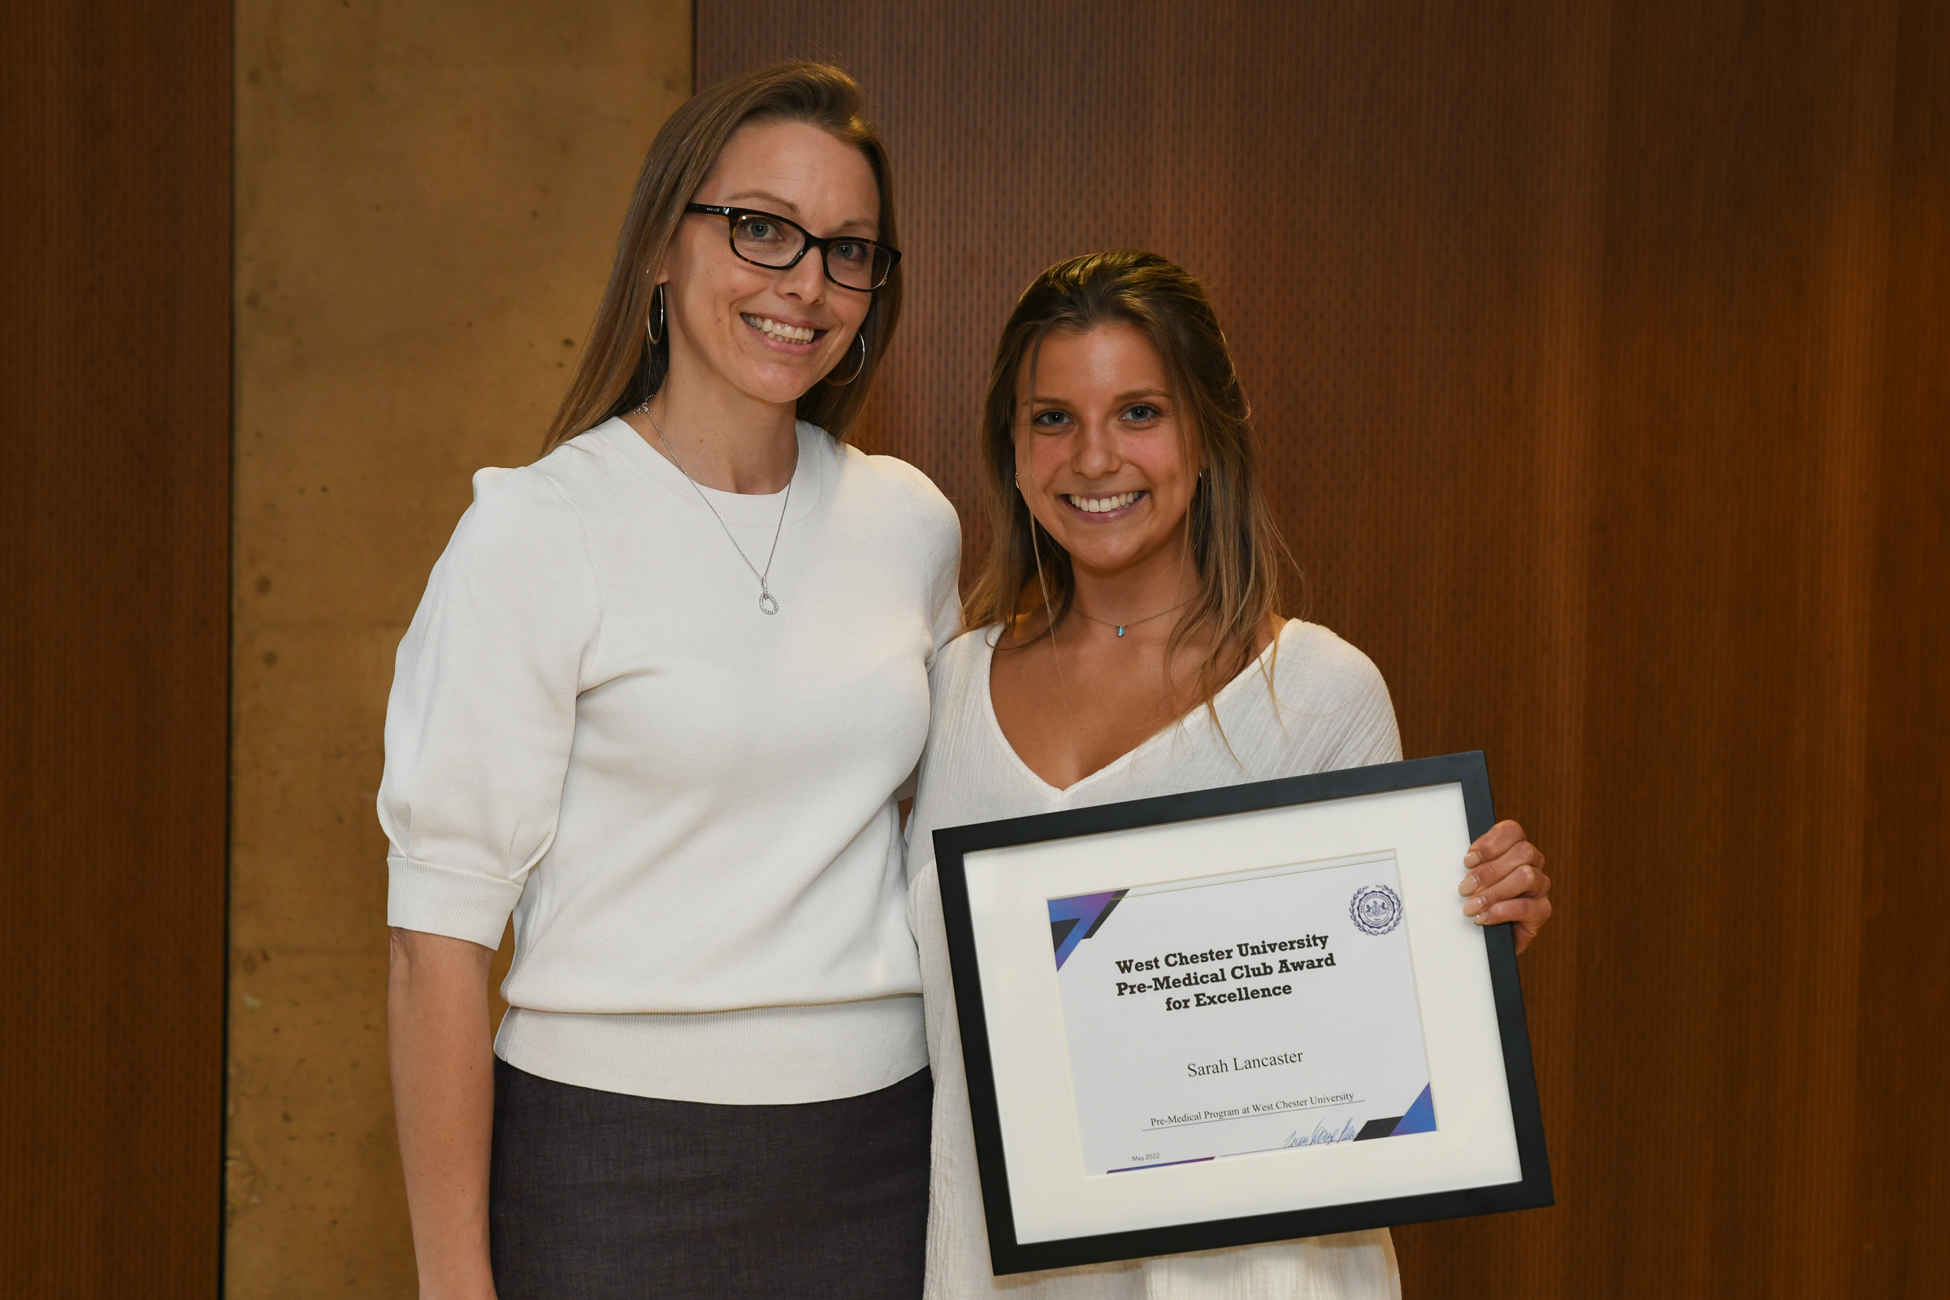
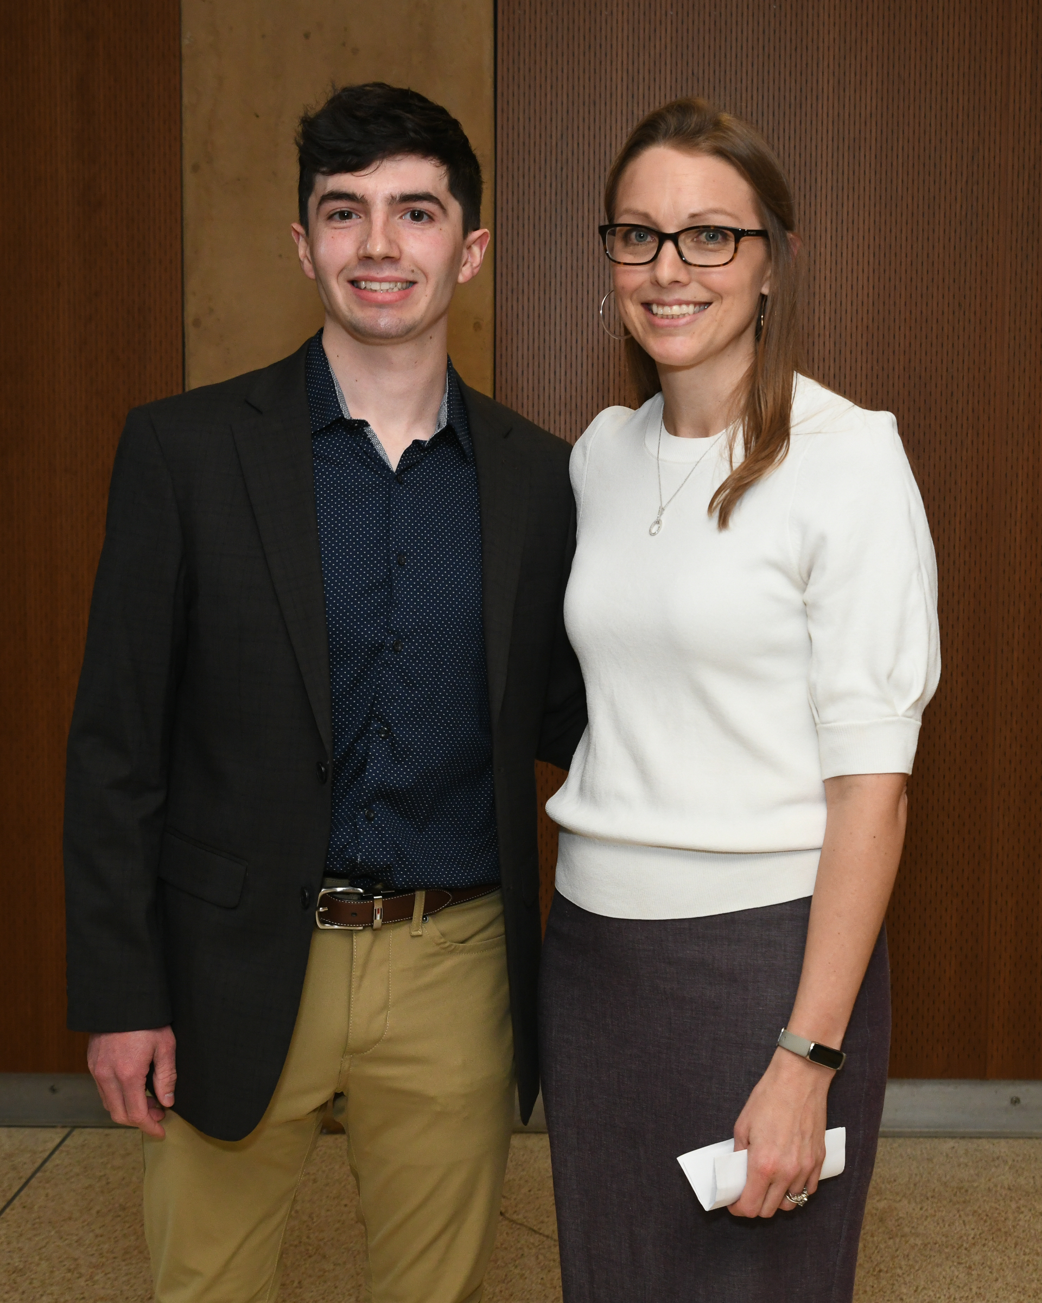
Pre Med 2022 Award Winners
Pictured: Dr. Teresa Donze-Reiner, Sarah Lancaster and Bailey Spittle
Notes:
Vernon intro slides (2mins)

Slide 18
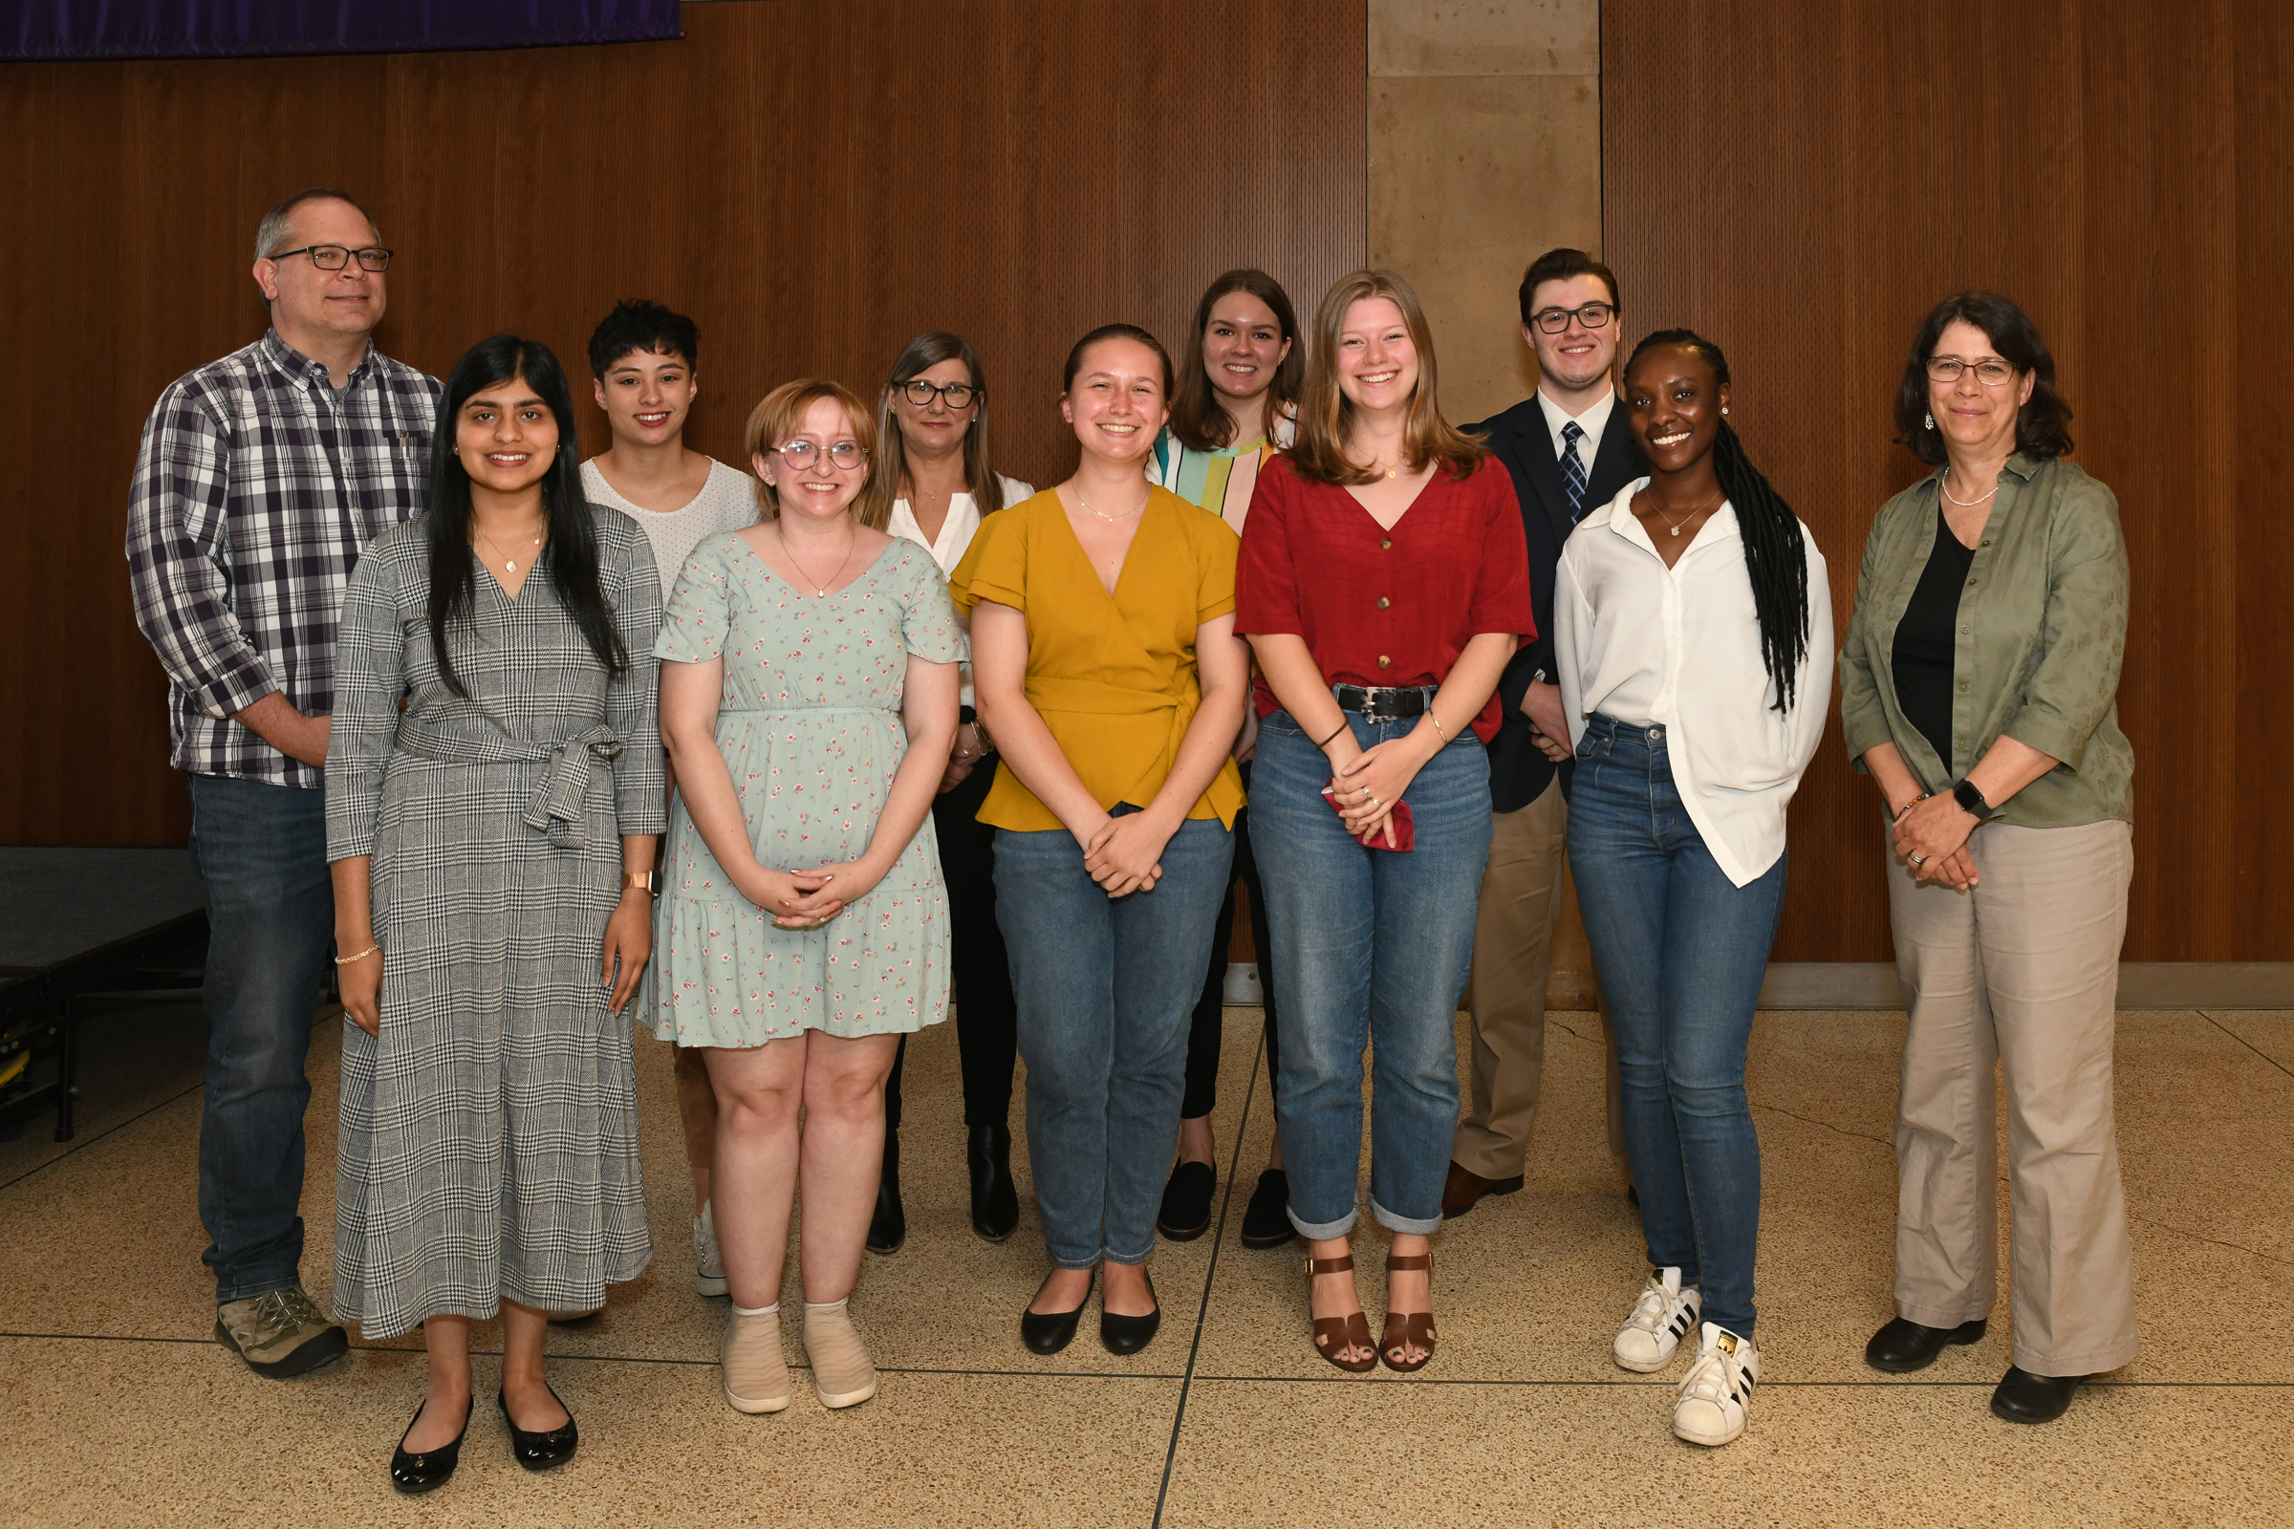
Political Science 2022 Award Winners
Pictured: Dr. Chris Stangl, Anum Syed, Elmira-Hope Ecklund, Jocelyn Brown, April Strunk, Corey Lane, Katherine Kerr, Edith Bradley, Eric Hanson, Niajah Mallard and Dr. Linda Stevenson
Notes:
Vernon intro slides (2mins)

Slide 19
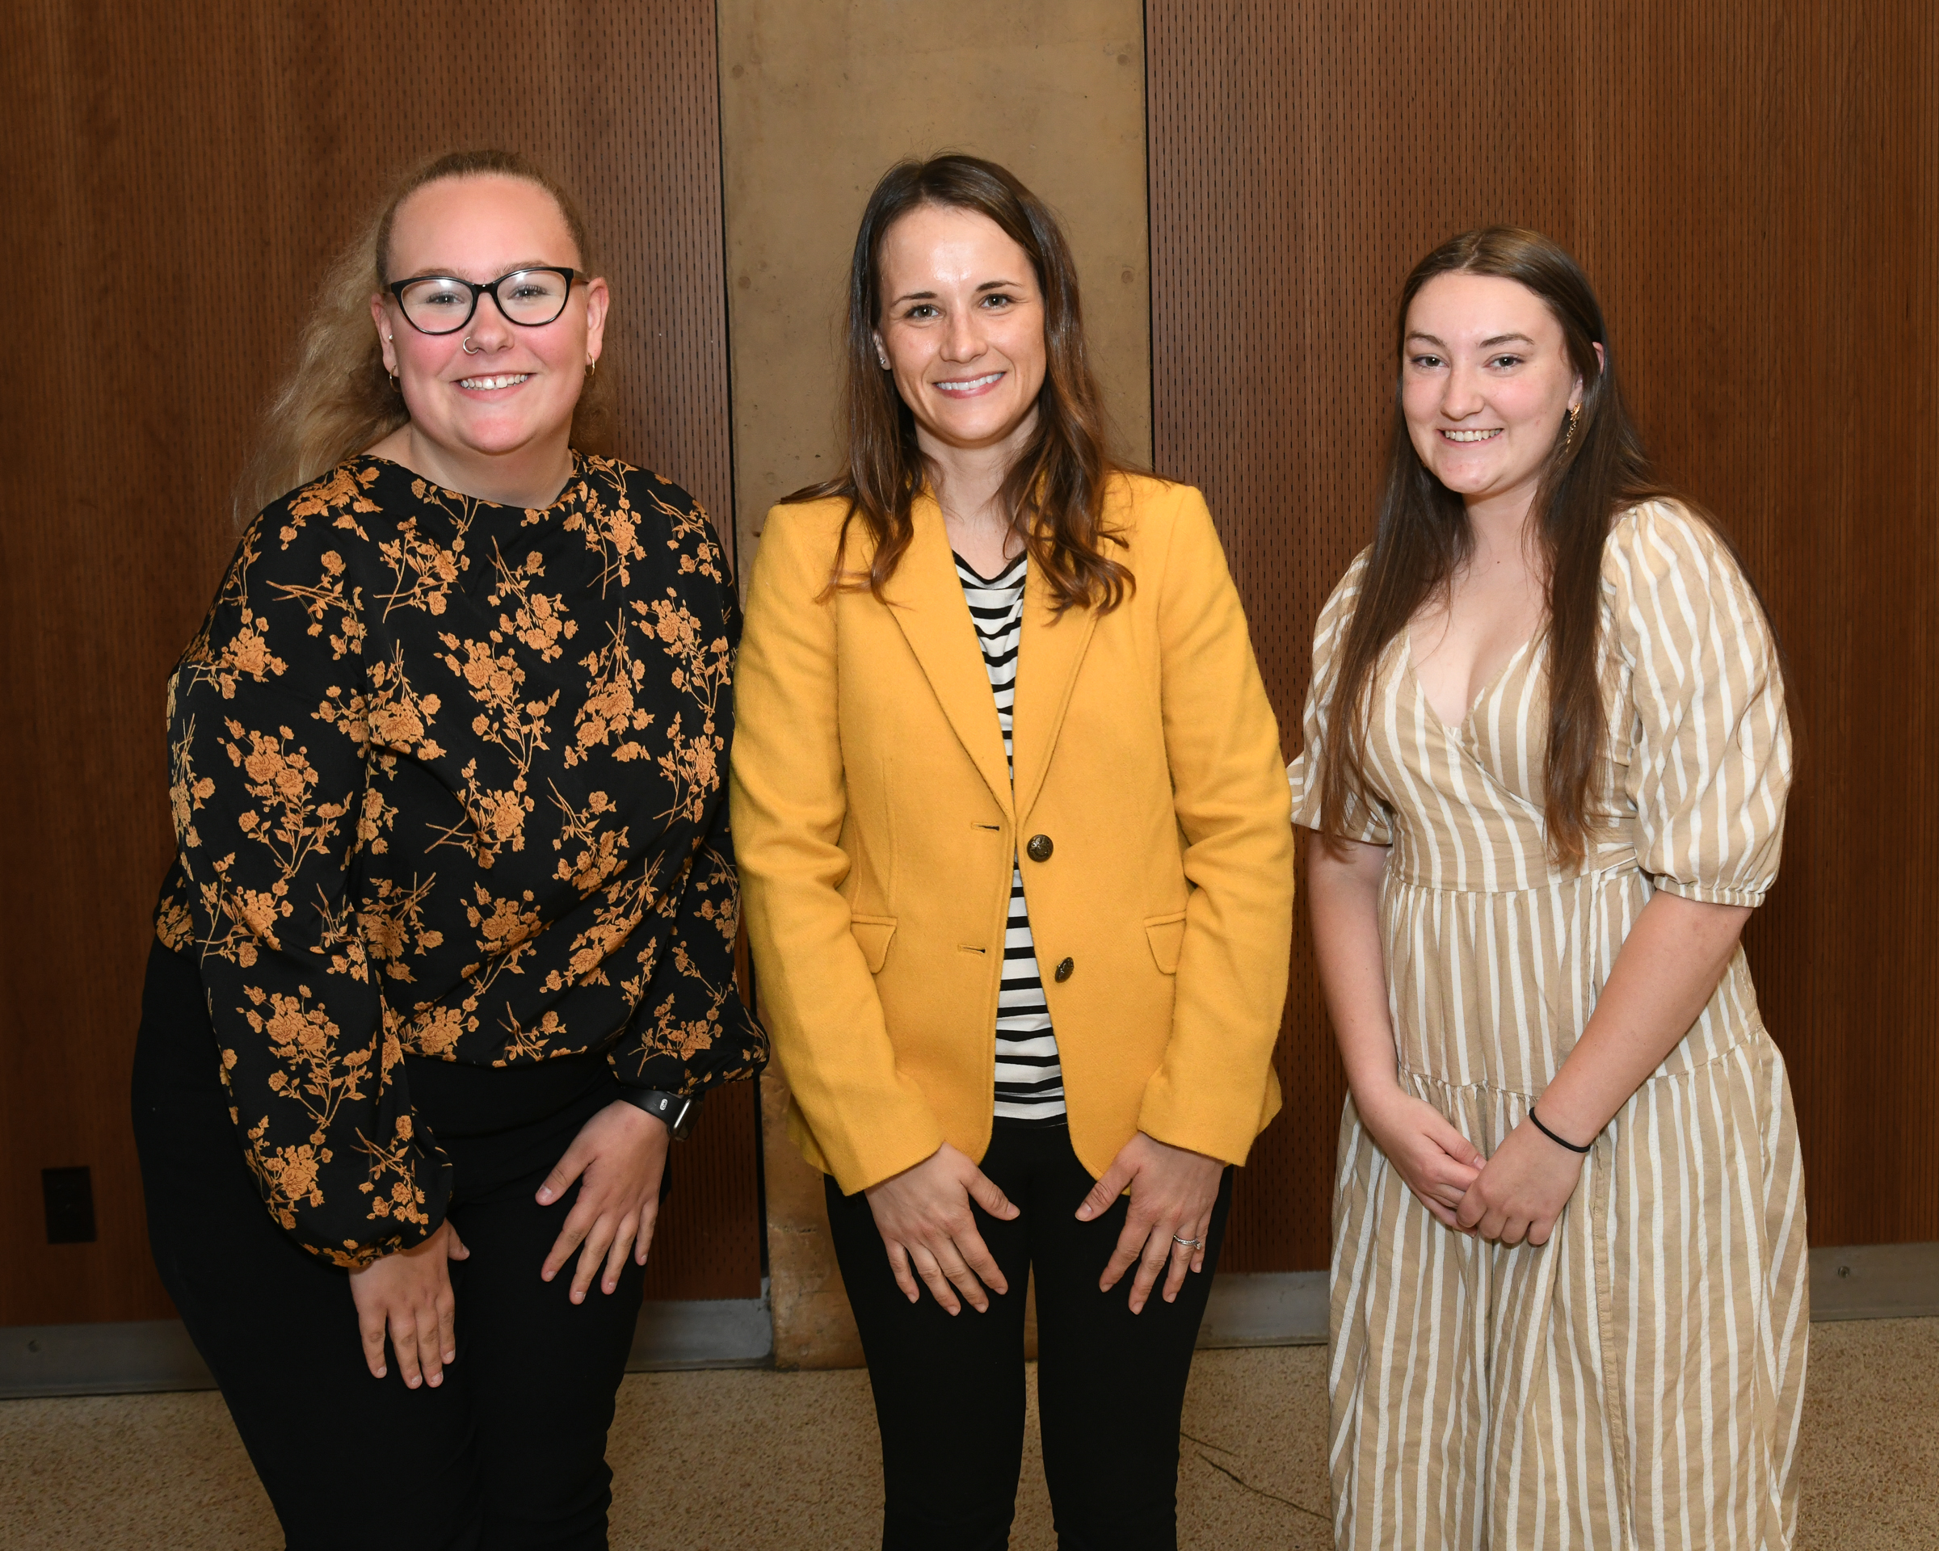
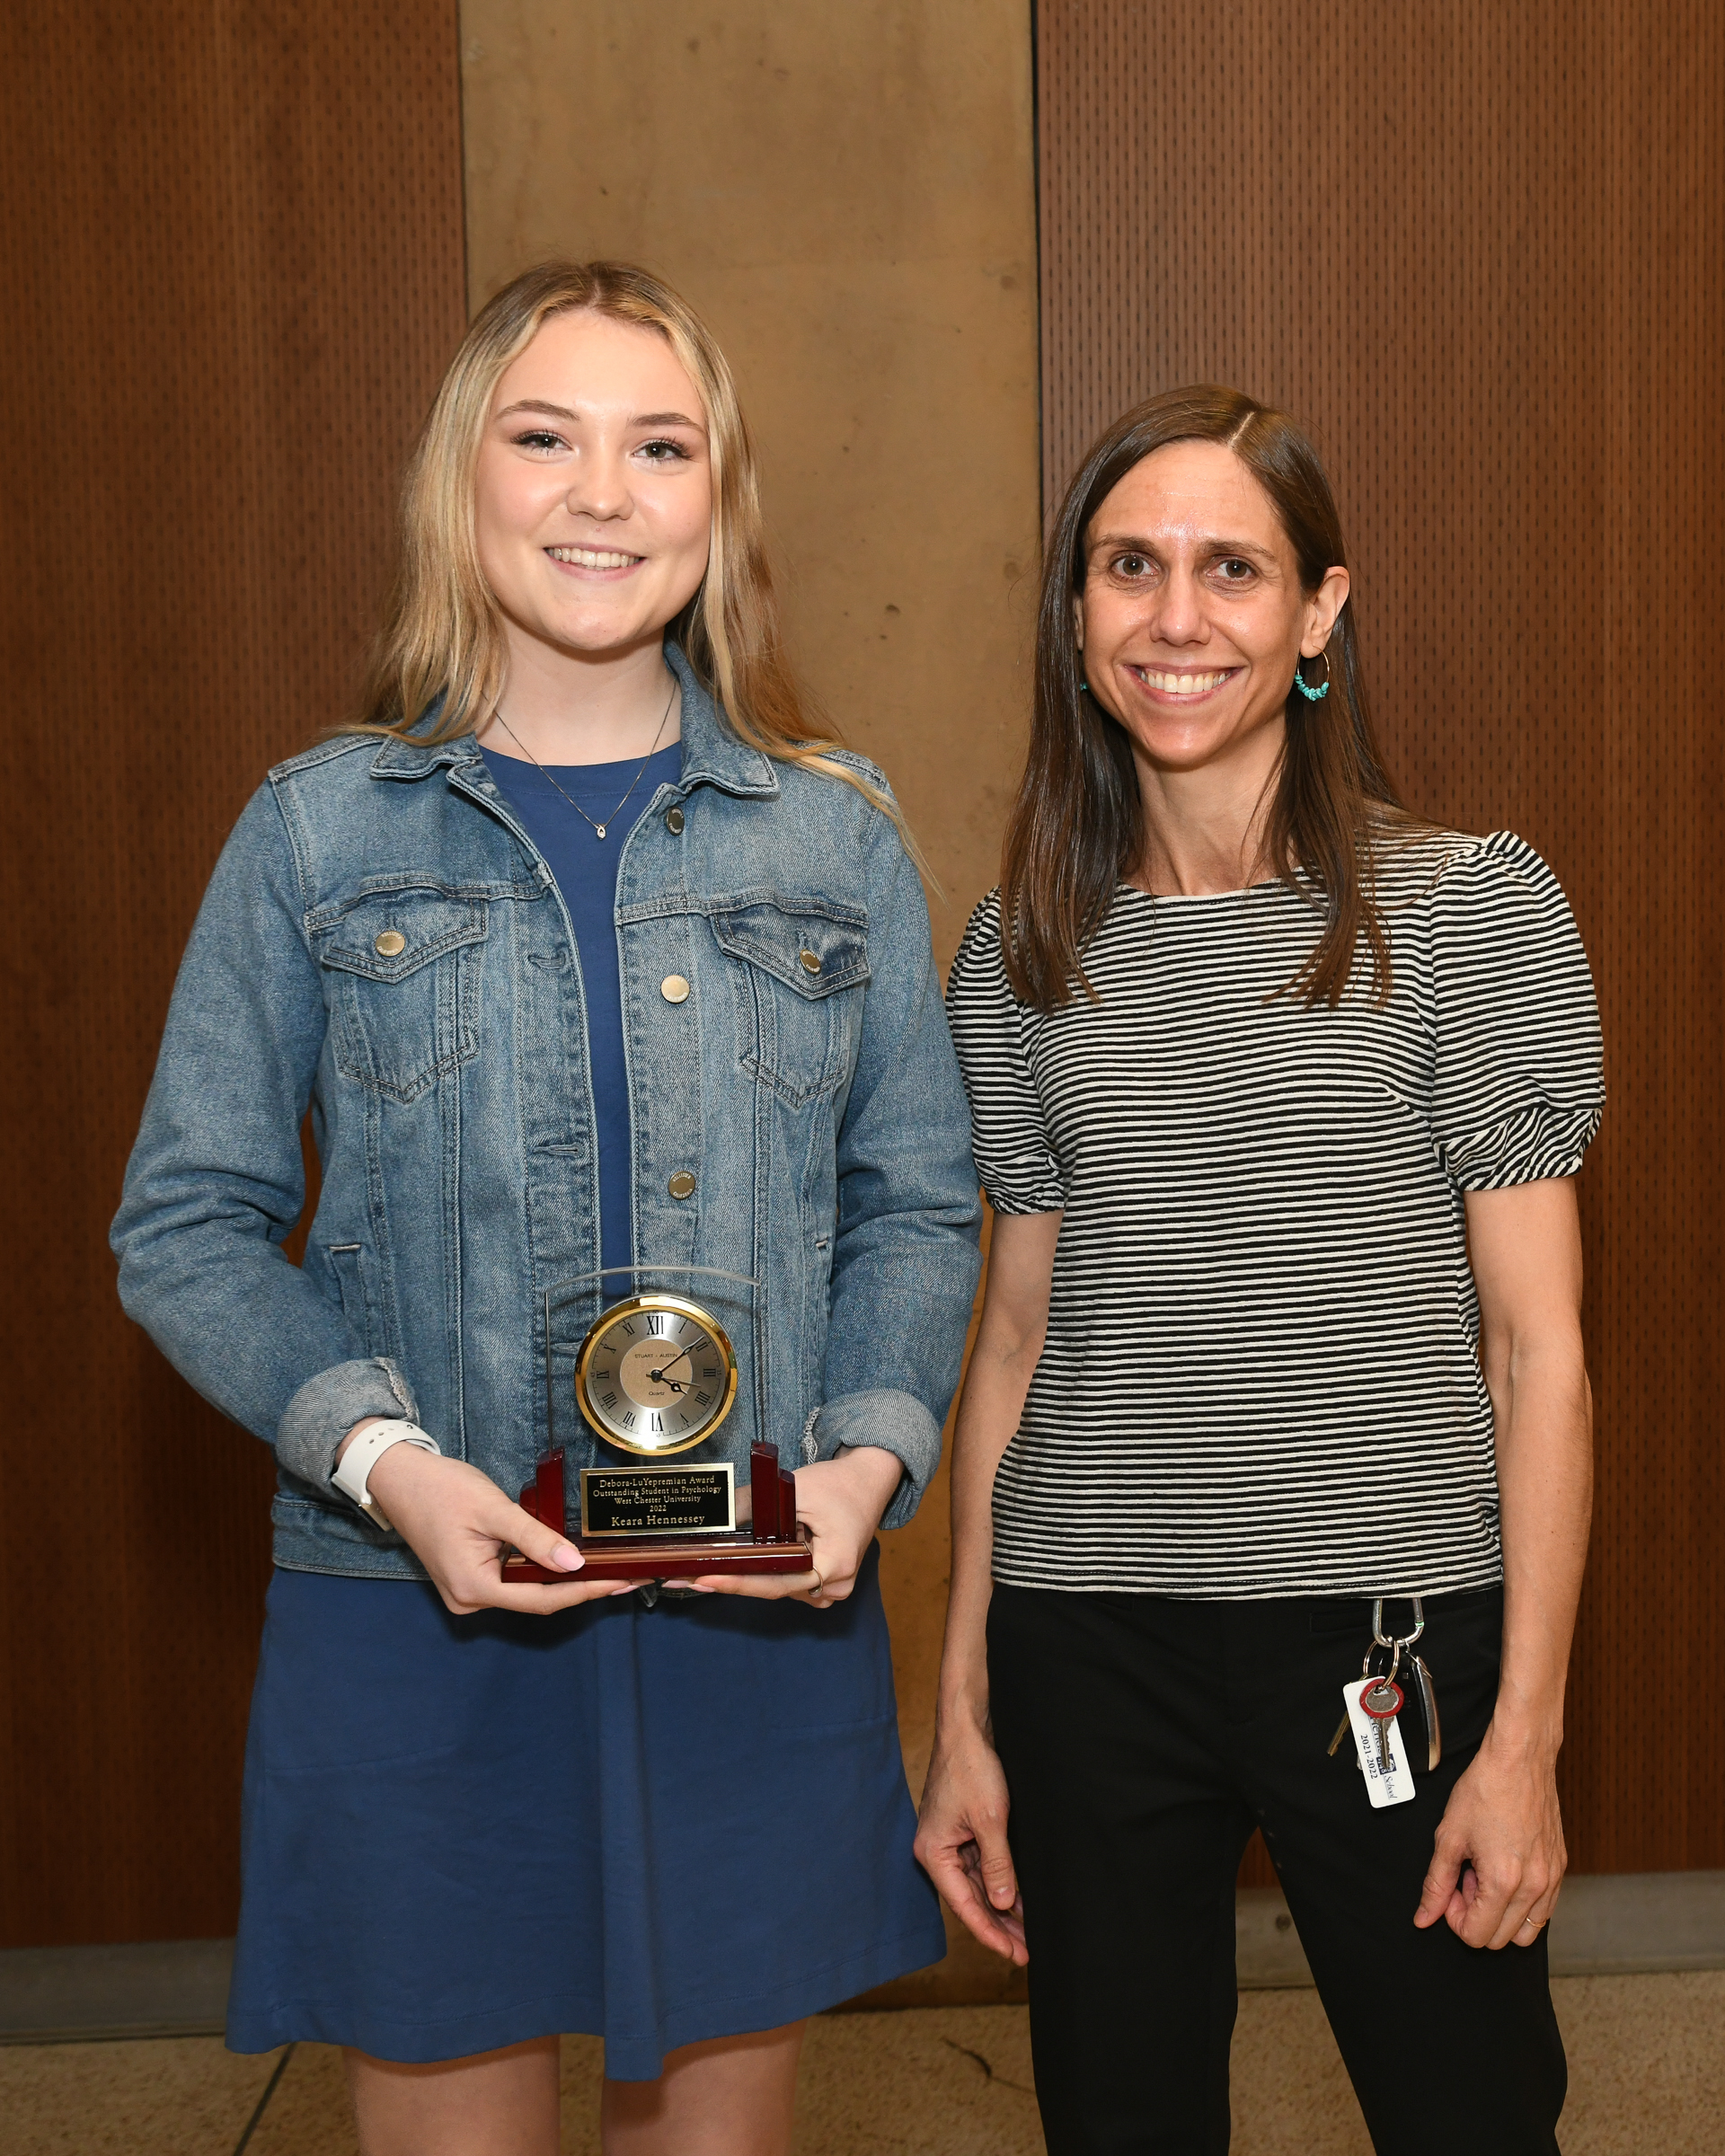
Psychology 2022 Award Winners
Pictured: Barrilynn Bender, Dr. Stevie Grassetti, Jenna Schreiber, Keara Hennessey and Dr. Ellie Brown
Notes:
Vernon intro slides (2mins)

Slide 20
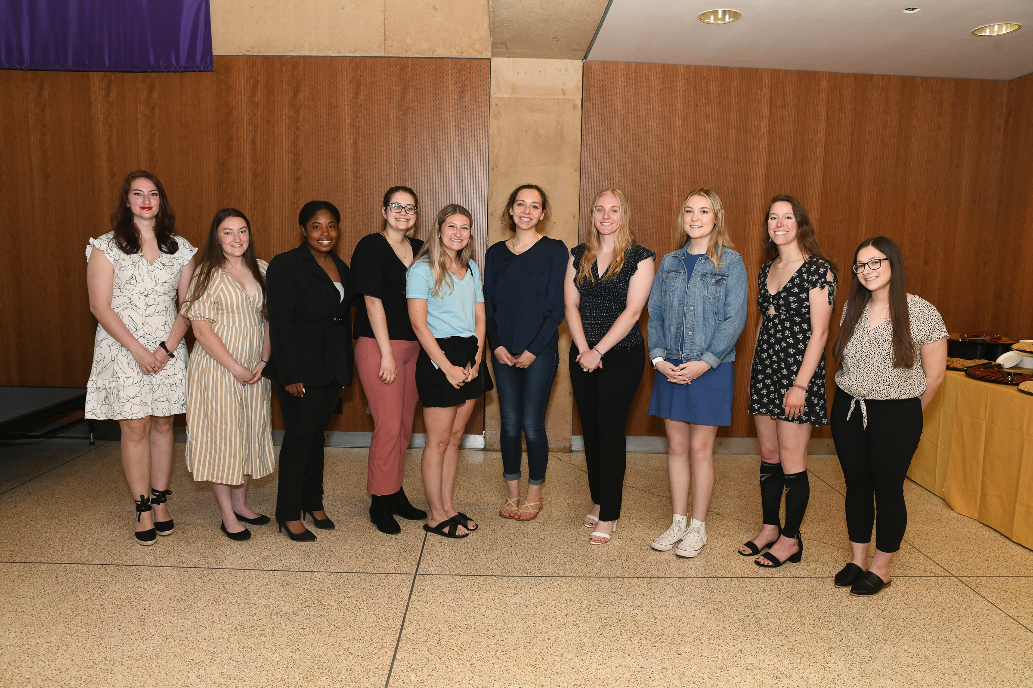
Psychology 2022 Service Awards
P
Pictured: Madison Beauregard, Amanda Geisinger, Nakira Hall, Keara Hennessey, Montana Kerr, Abigail Miller, Margaret Prezuhy, Katelyn Rogers, Lexie Russell and Jenna Schreiber
Notes:
Vernon intro slides (2mins)

Slide 21
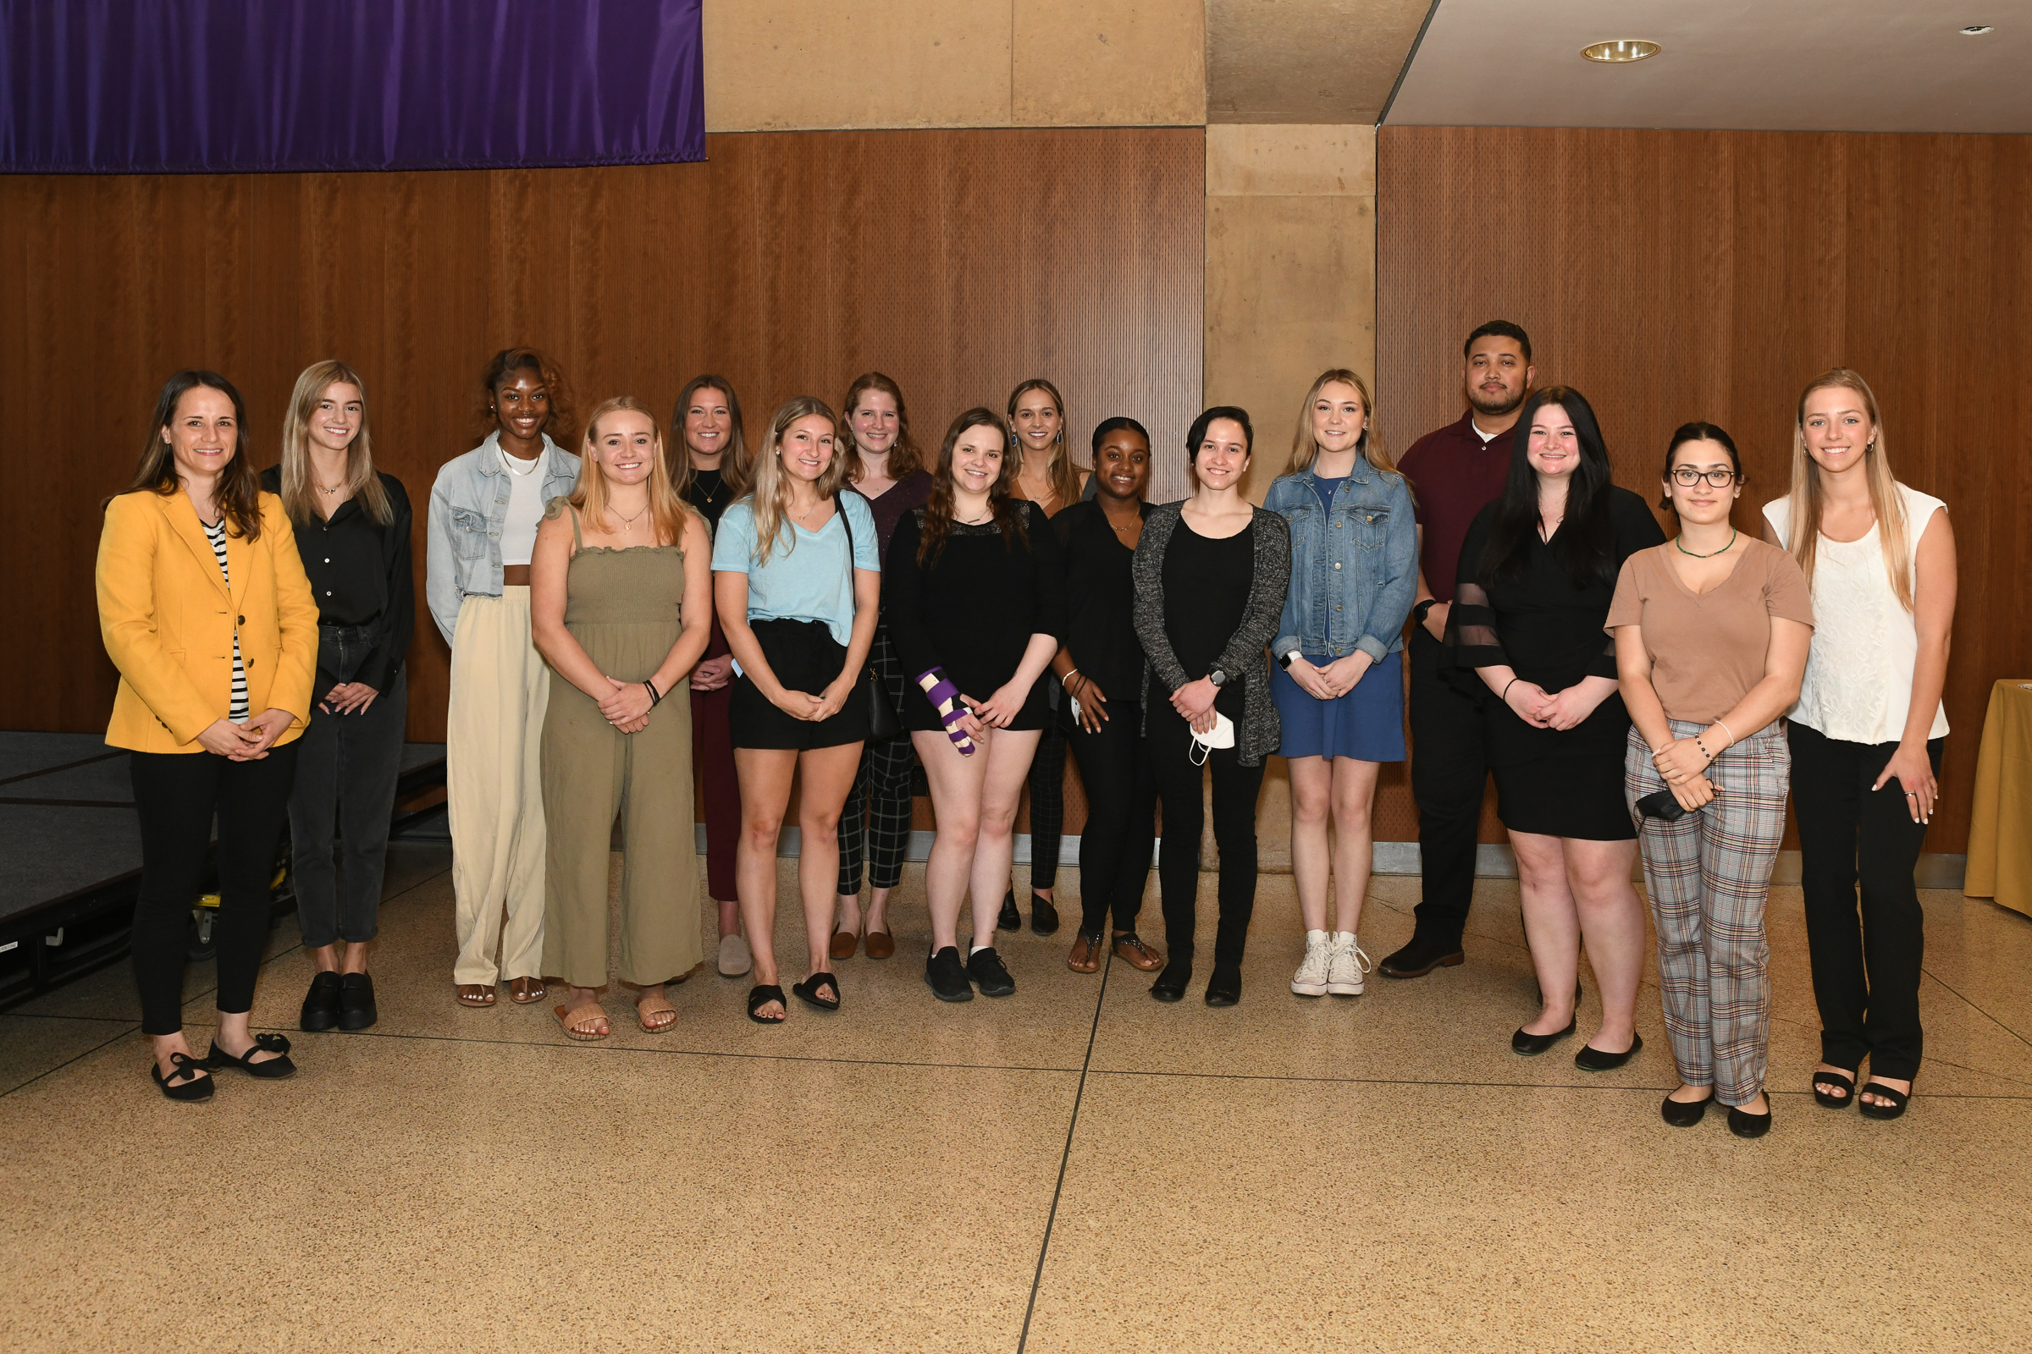
Psychology 2022 Research Awards
Pictured: Dr. Stevie Grassetti, Lindsay Corkery, Hannah Crespy, Anthony Ferroni, Keara Hennessey, Lena Hull, Kayla Kinsey, Natalie Leonard, Nicole Lyman, Bailey McManus, Jasmin Miller, Abigail Miller, Elizabeth M. Stanton, Sara Stavely and Gianna Yuhas
Notes:
Vernon intro slides (2mins)

Slide 22
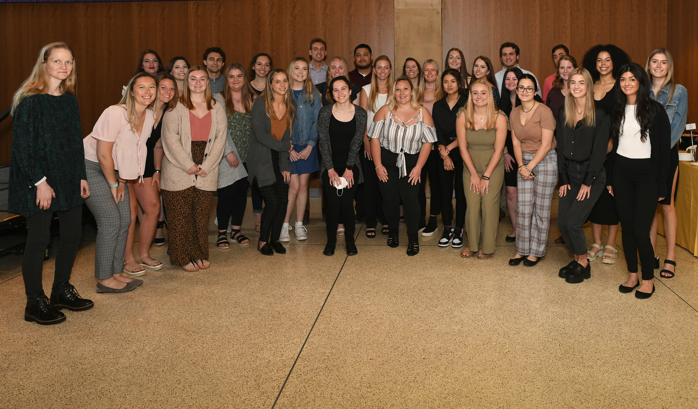
Psychology 2022 Academic Awards
Pictured: Madison Beauregard, Lizzie Brost, Maura Casey, Lindsay Corkery, Hannah Crespy, Emily Dawson, Anthony Ferroni, Katherine Ford, Amanda Geisinger, Lauran Gillow, Keara Hennessey, Dylan Hintenach, Lena Hull, Lyra Jones, Cole Kelley, Nicole Lyman, Bailey McManus, Alexia Montgomery, Tyra Paisley, Daniel Papa, Madeline Patton, Rebecca Powell, Margaret Prezuhy, Katelyn Rogers, Sara Stavely, Julianna Stewart, Renee Taing, Gillian Thomas, Julia Tuckey, Jaime Webb, Gianna Yuhas and Collin Wainwright
Notes:
Vernon intro slides (2mins)

Slide 23
To access the full program, including award winners not pictured use the QR Code :

